Slide 1

Version control with Github Desktop
Shuai Wei
IS&T Boston University

Slide 2
Git: main features
Track all your changes
Work along with others
Share work with others

Slide 3
Git Workflow

Slide 4
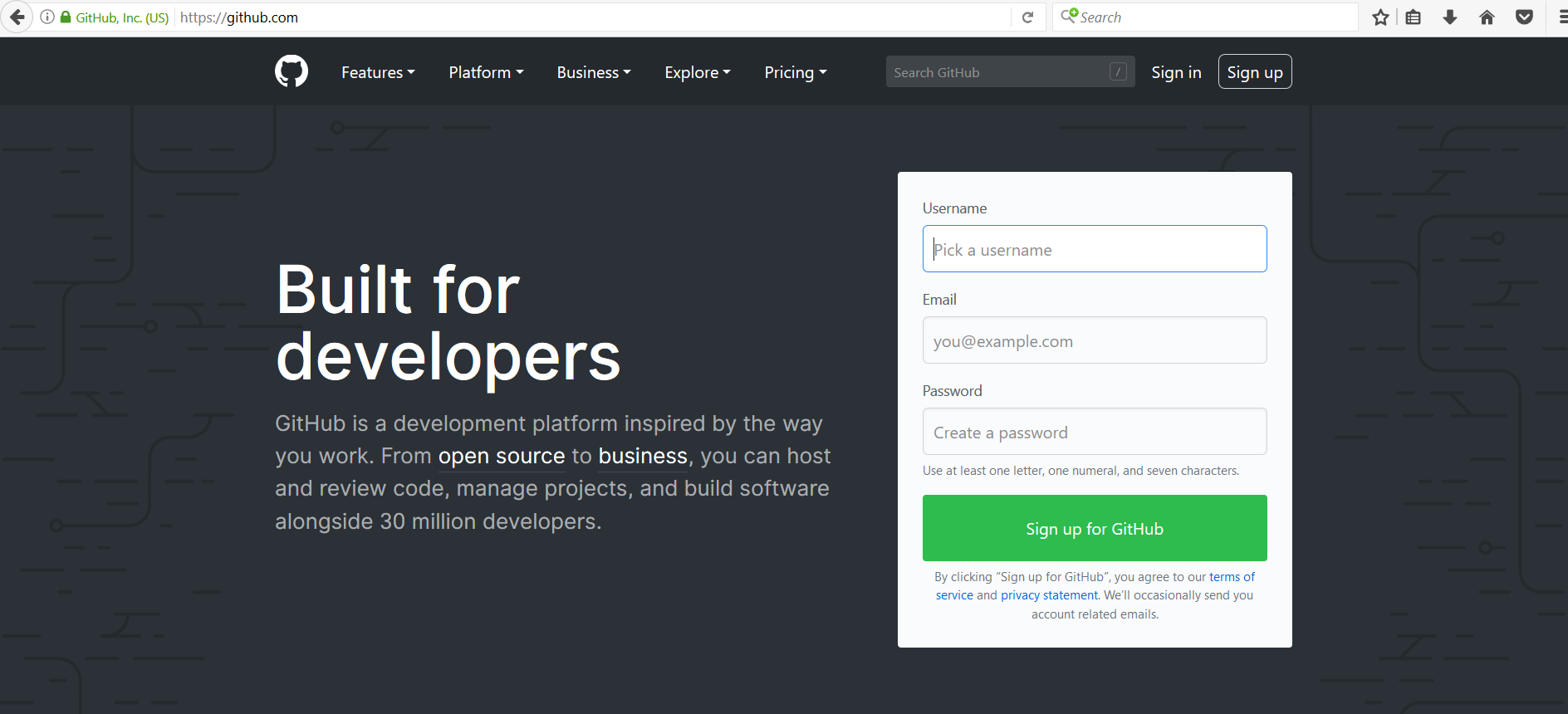
Github.com
A web-server that allows you to save/access your repository remotely.
Easy to share with collaborators.

Slide 5
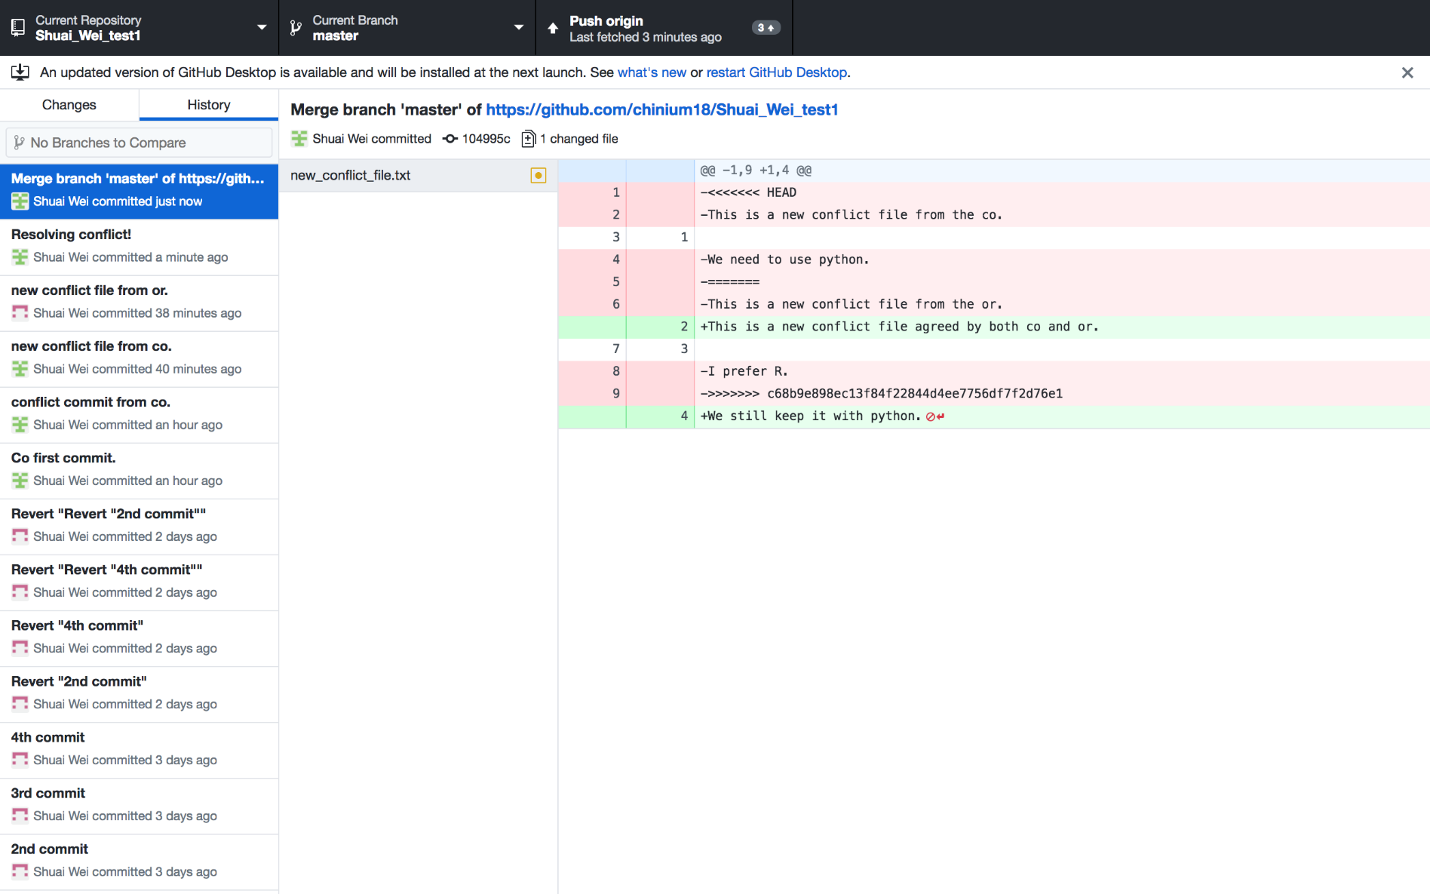
GitHub desktop
It’s a fast, easy way to contribute to projects from OS X and Windows.
GitHub workflow and replace GitHub for Mac and Windows with a unified experience across both platforms.

Slide 6
Setting up GitHub Desktop
Installing GitHub Desktop
https://desktop.github.com/
Authenticating to GitHub
Add your GitHub.com account information to GitHub Desktop
Configuring Git for GitHub Desktop
If you don’t have Git installed, you must configure it before using GitHub Desktop.

Slide 7
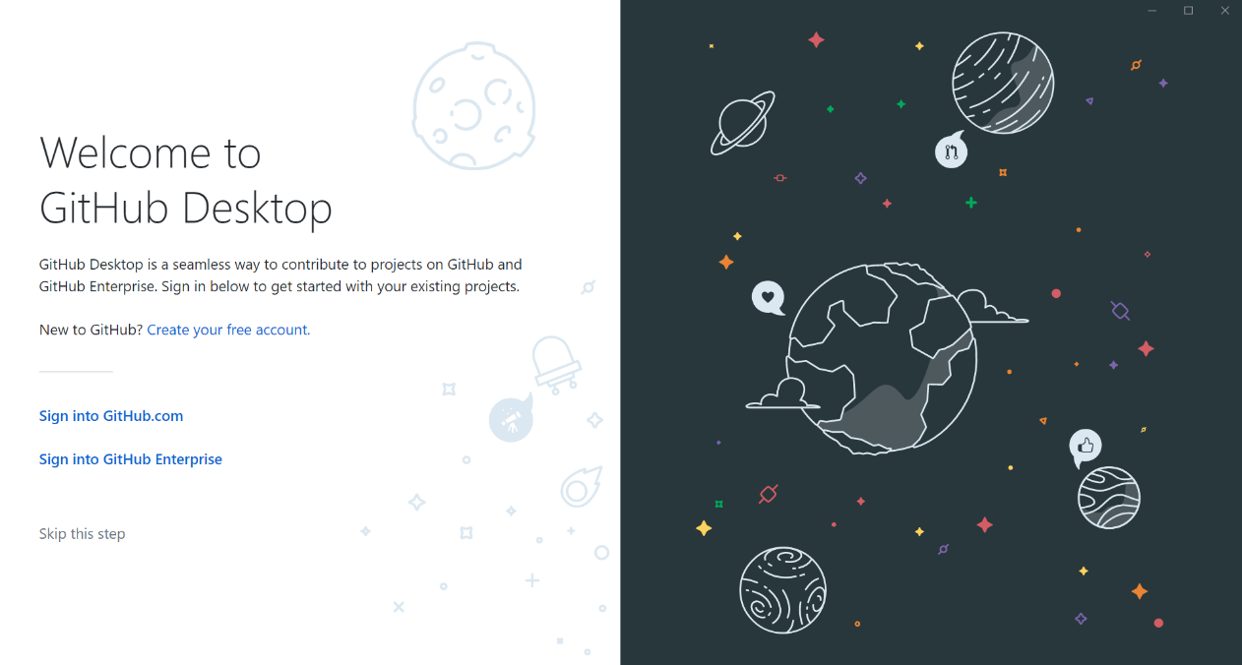
Authenticating to GitHub
or

Slide 8
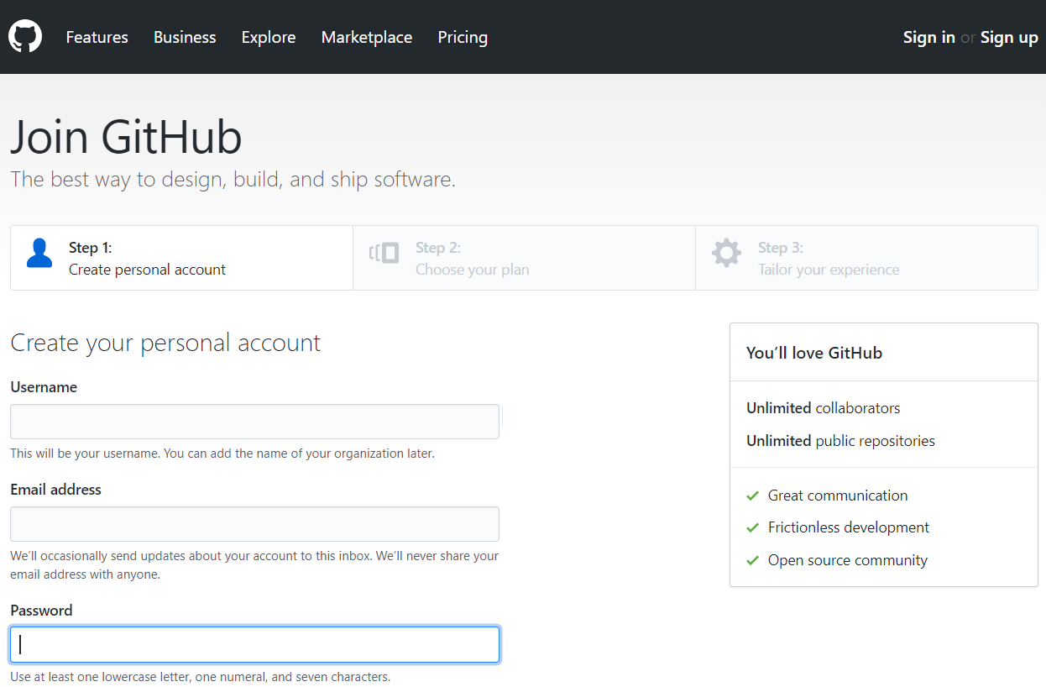
Creating GitHub account if you don’t have an account already

Slide 9
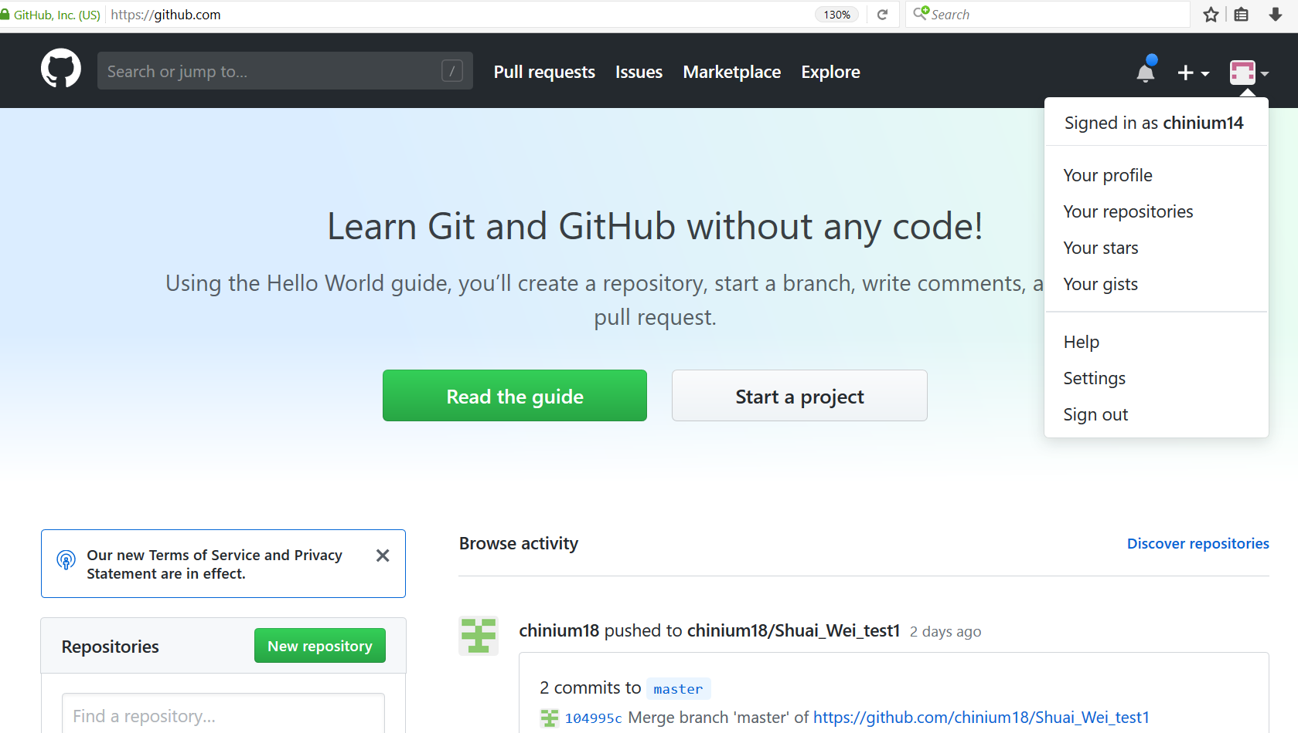
Configuring GitHub account

Slide 10
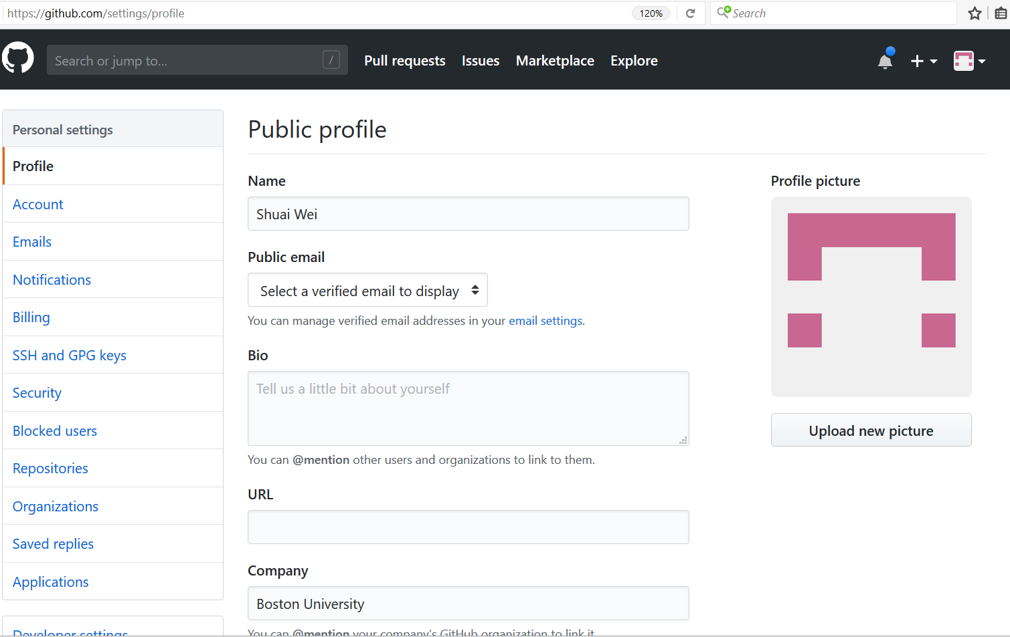
Configuring GitHub account

Slide 11
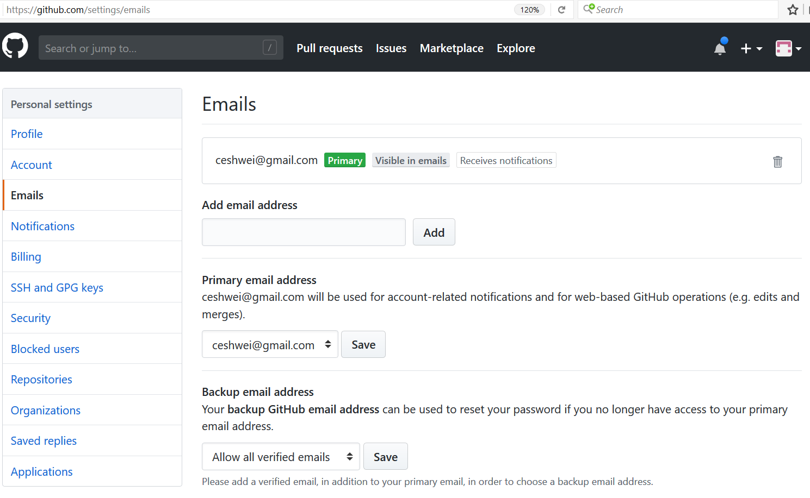
Configuring GitHub account

Slide 12
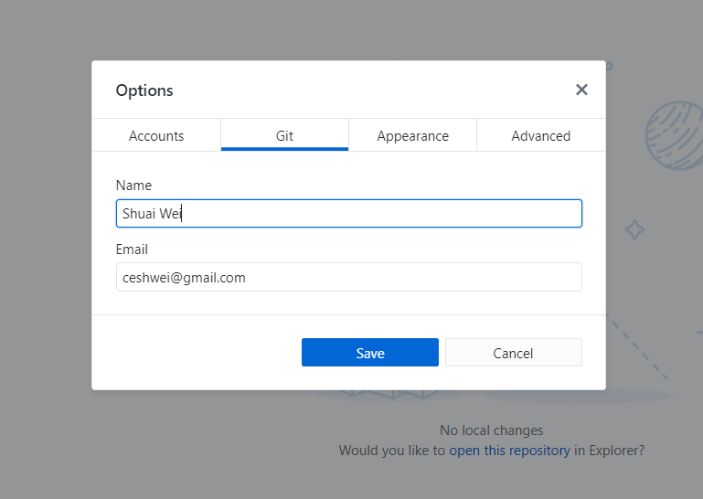
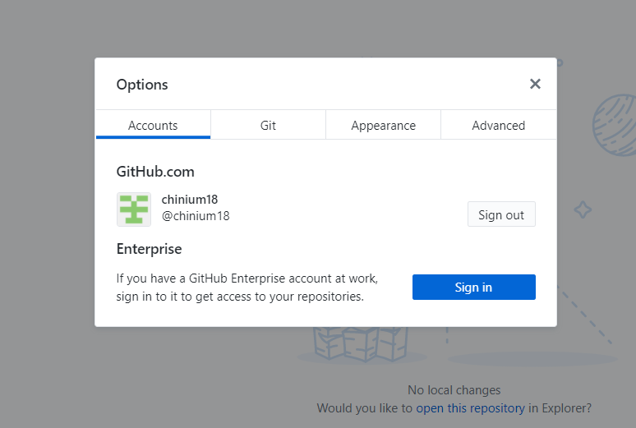
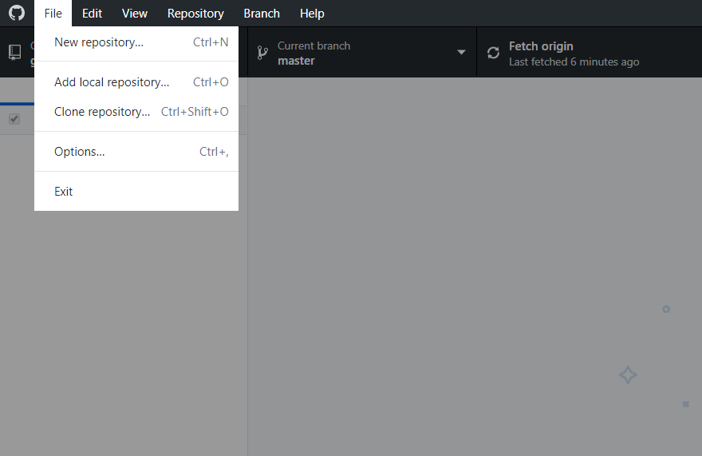
GitHub Desktop Setup

Slide 13
Using Github desktop for version control
Track and visualize each update of your code.
Revert a previous version/commit.
Branch out for large project development.

Slide 14
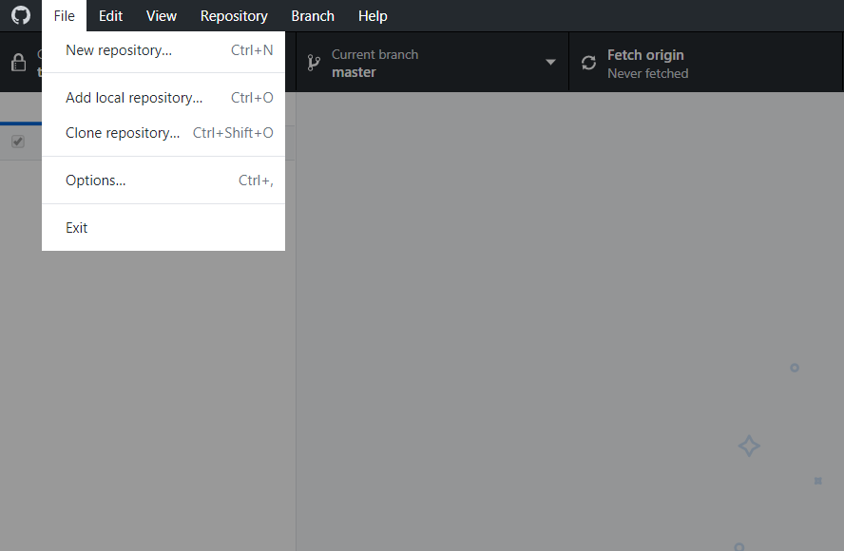
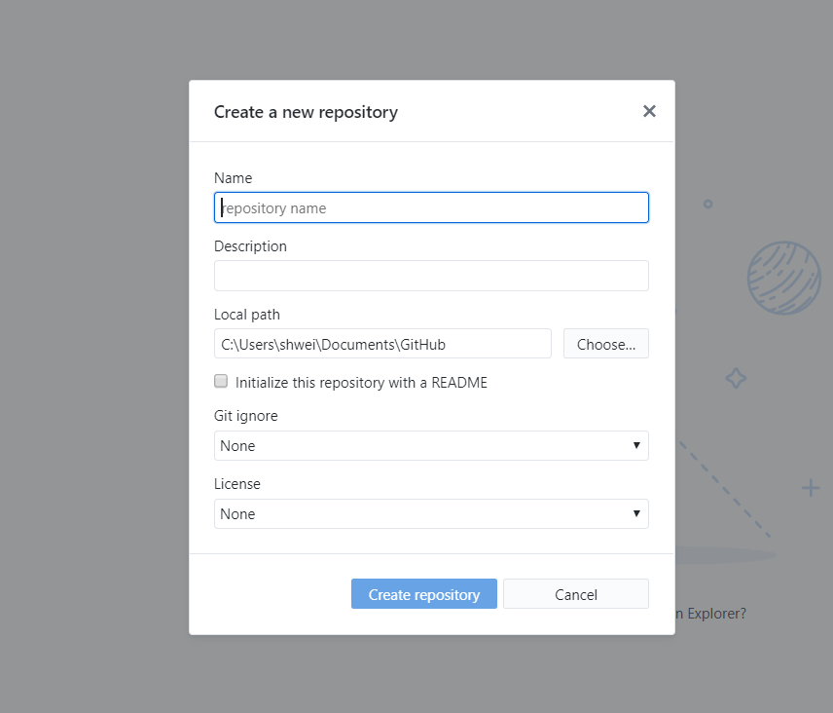
Now we can start a new project (repository) from scratch.

Slide 15
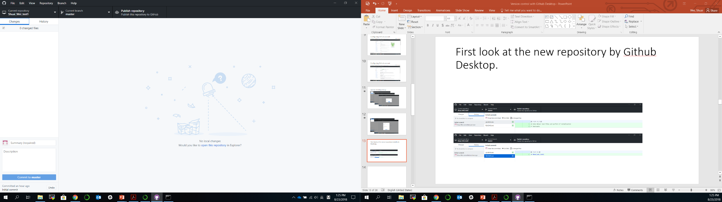
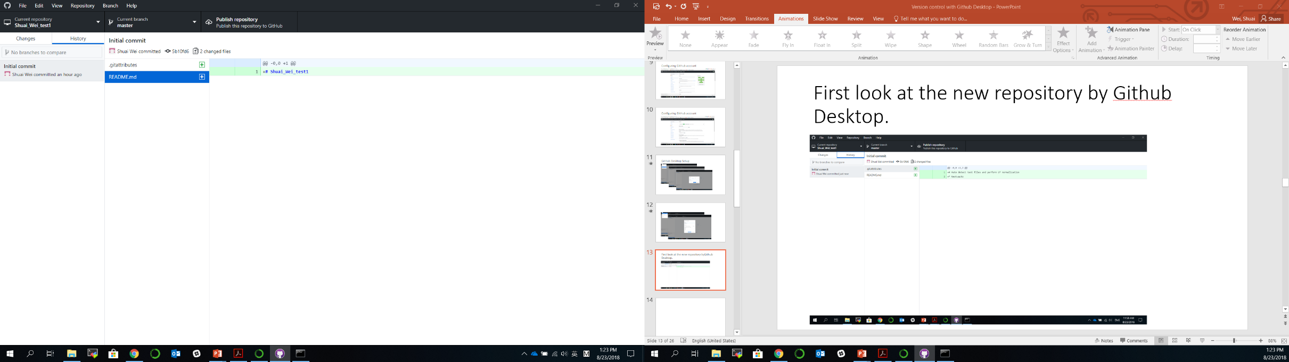
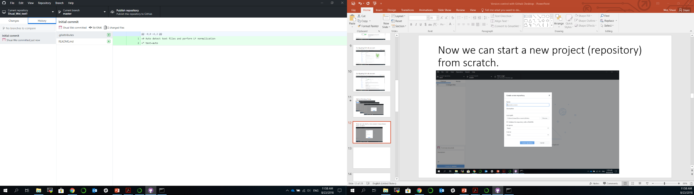
First look at the new repository by Github Desktop.

Slide 16
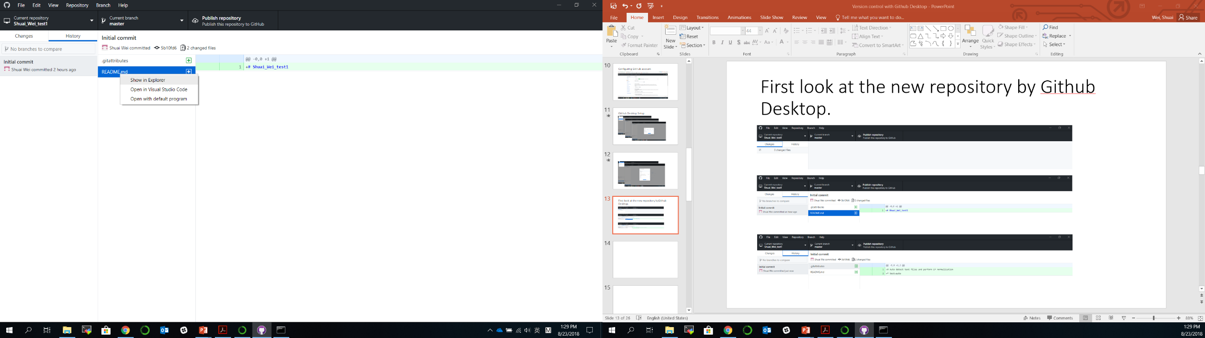
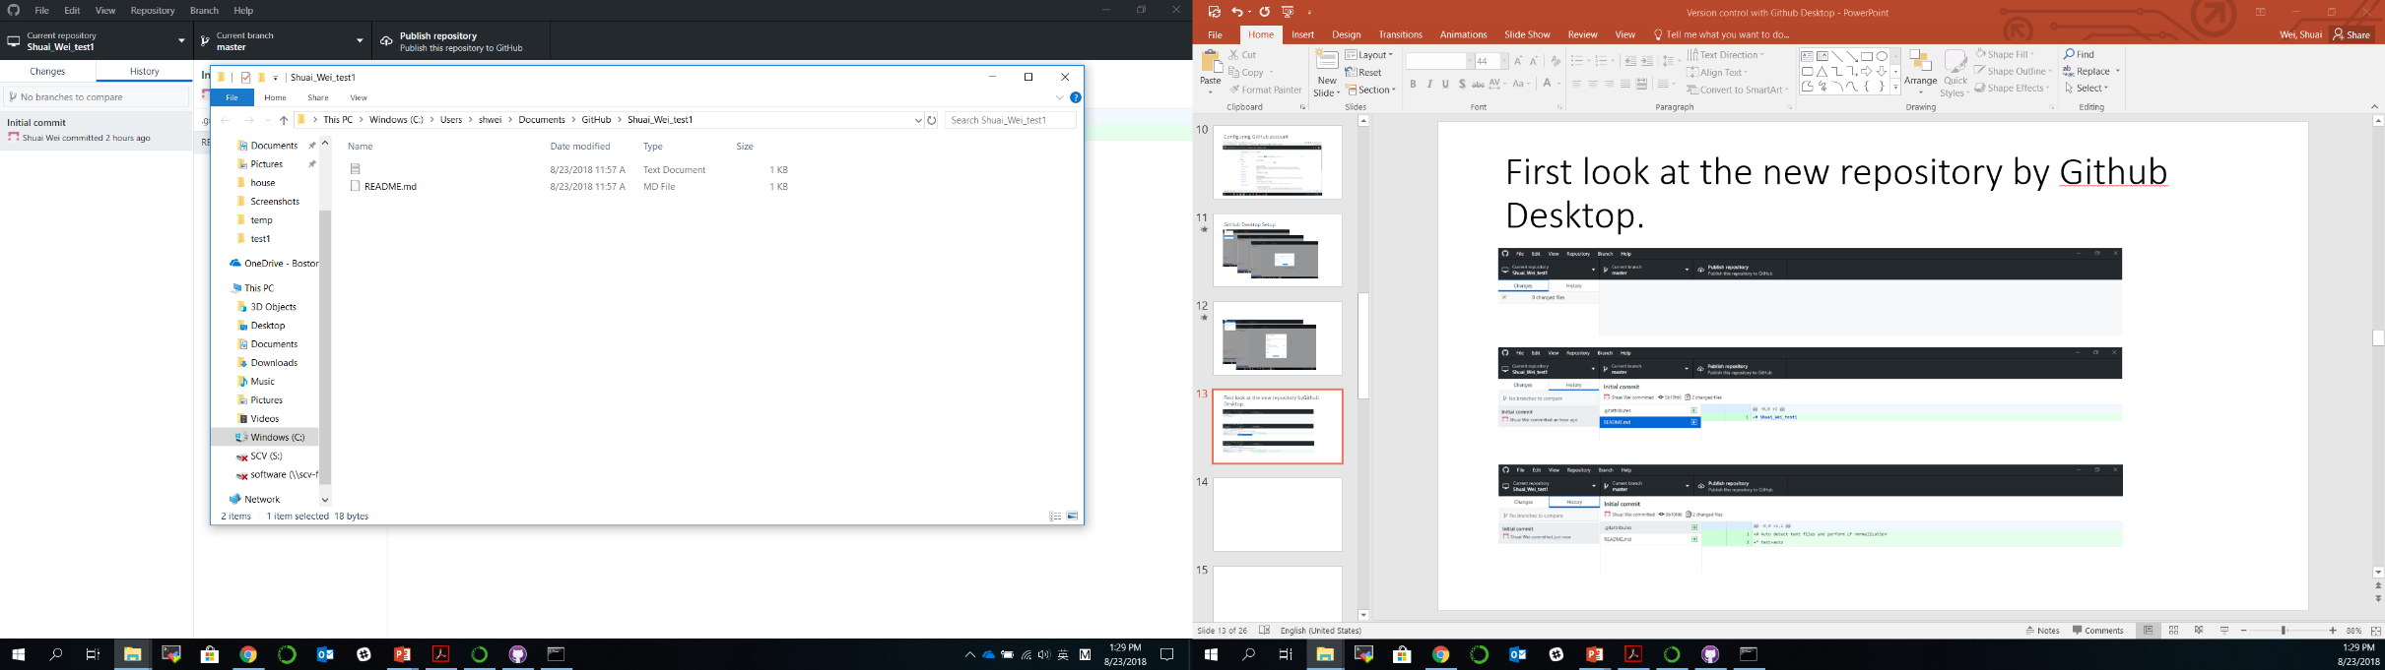
Show in folder and edit files/codes
Right click

Slide 17
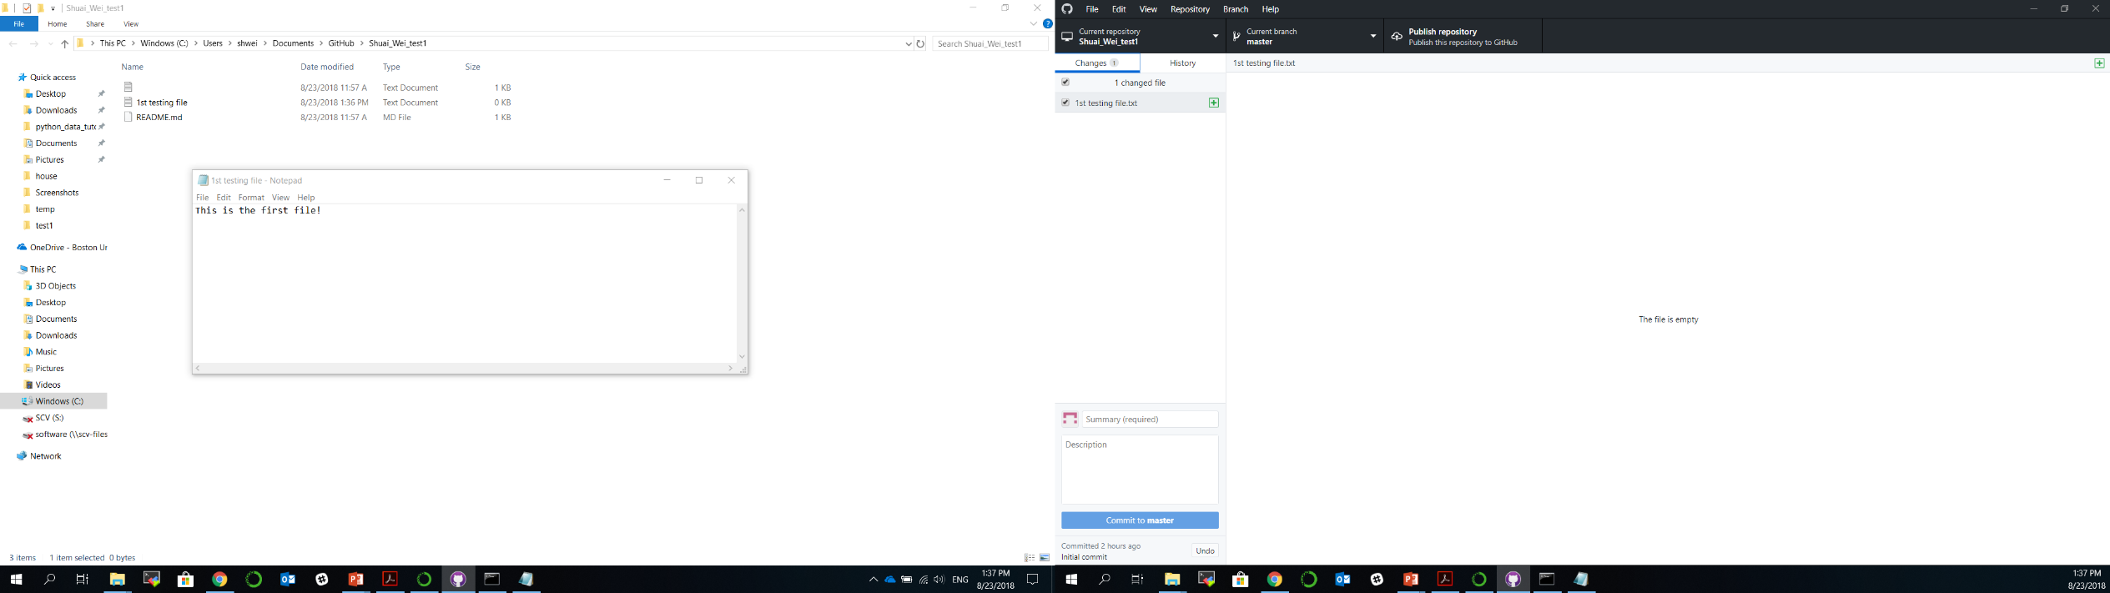
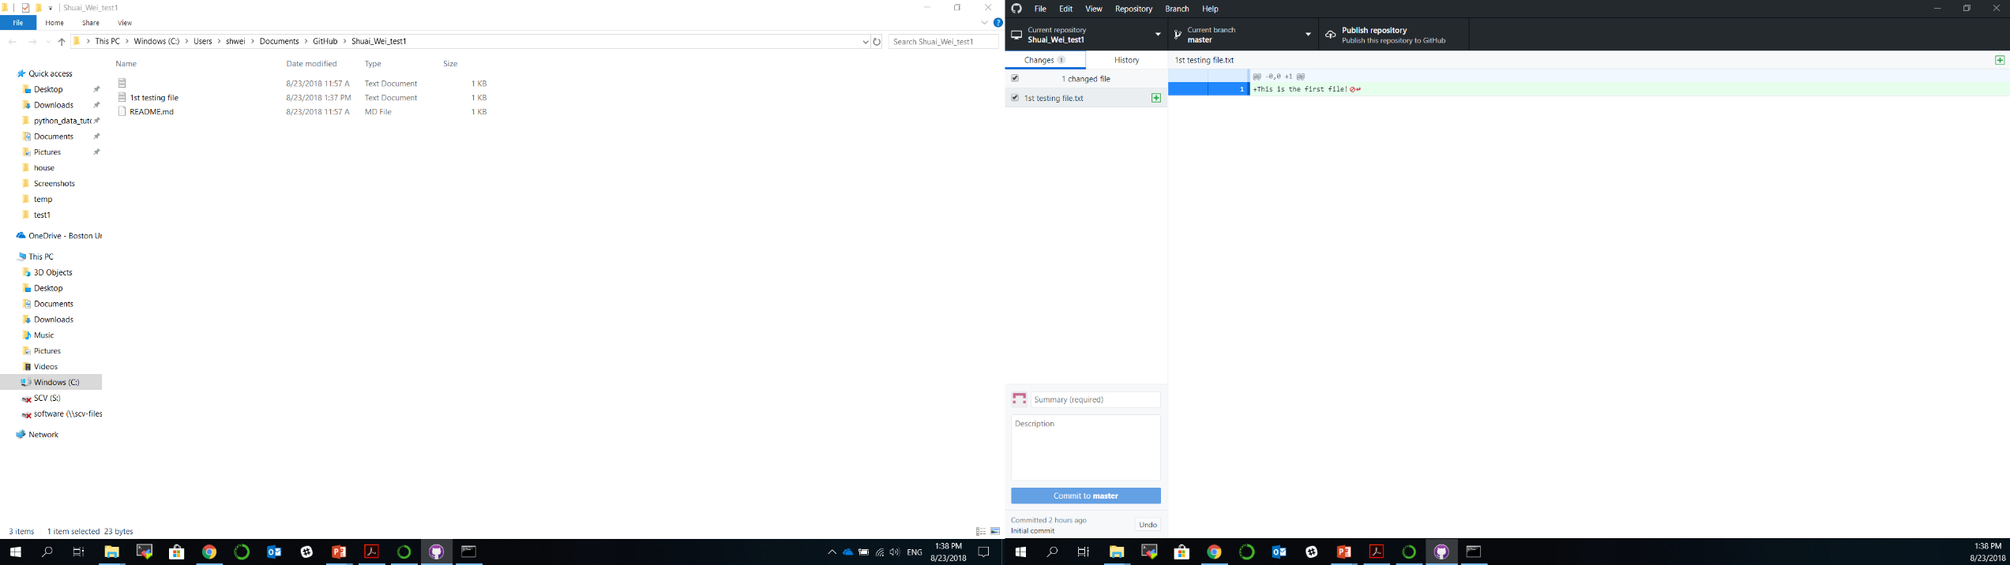

Slide 18
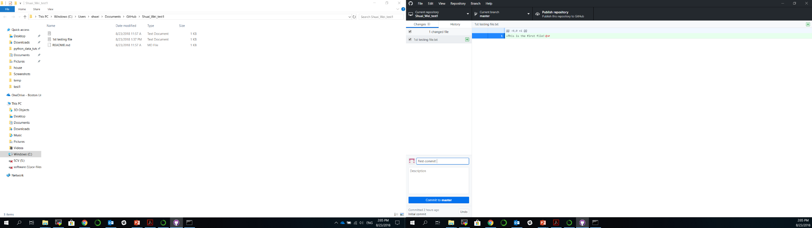
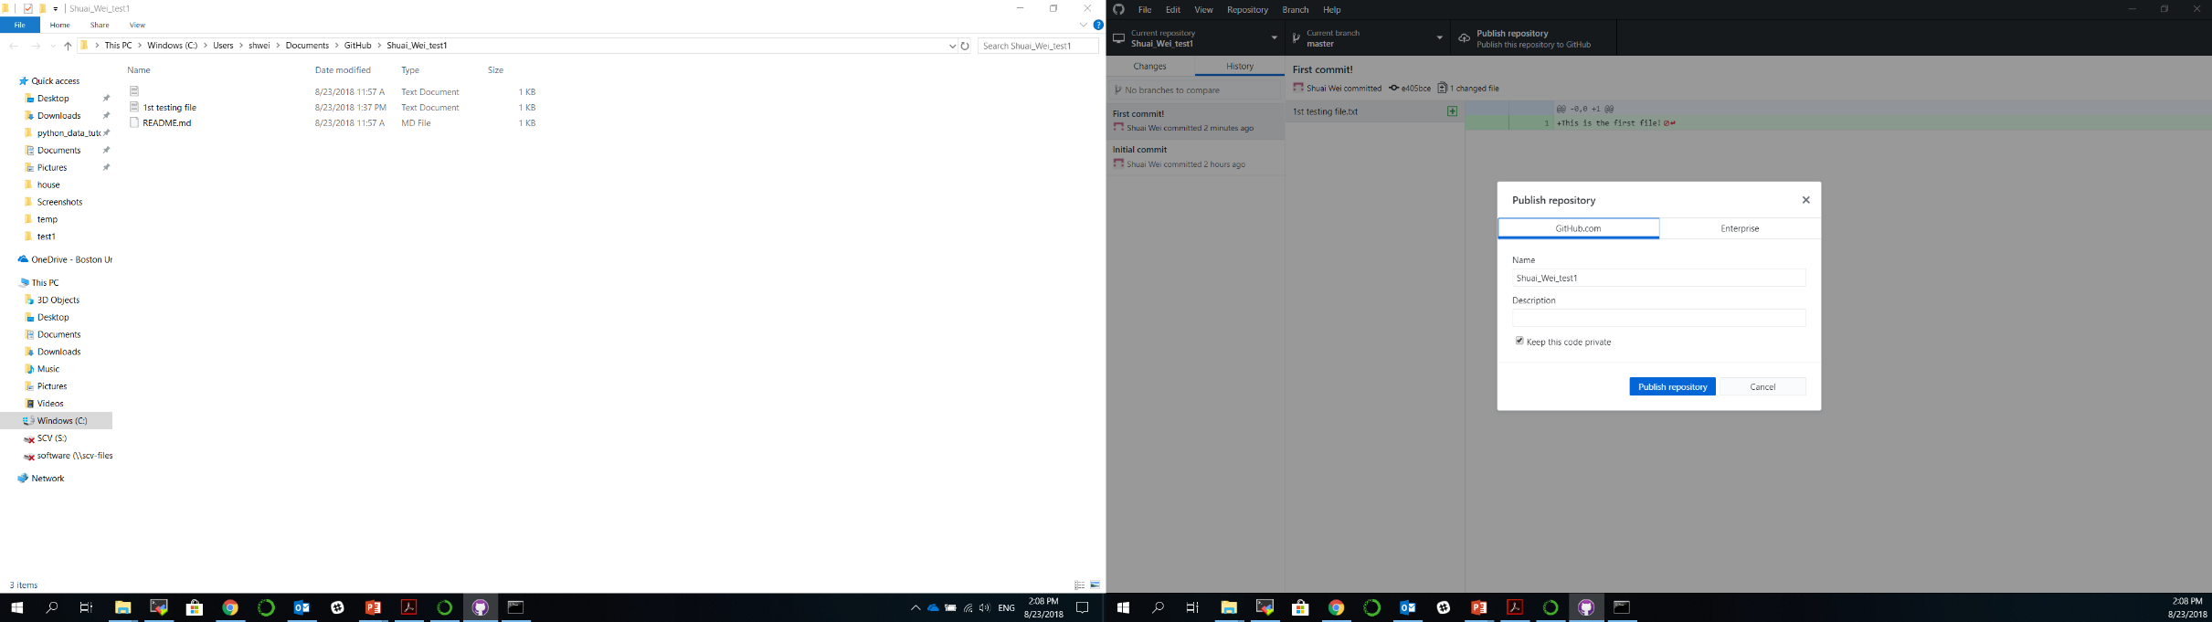
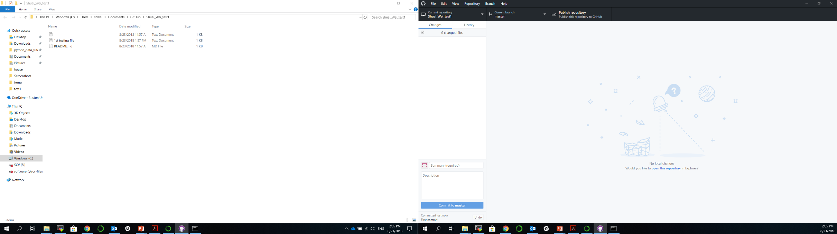
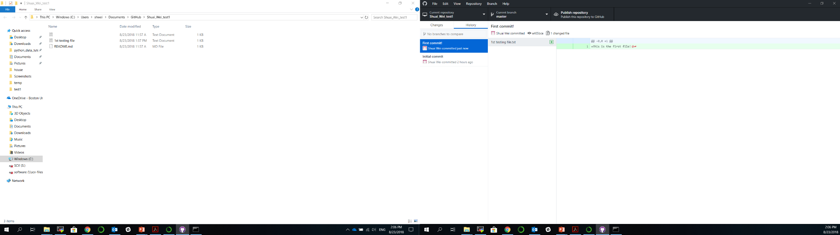
1st commit
1st push

Slide 19
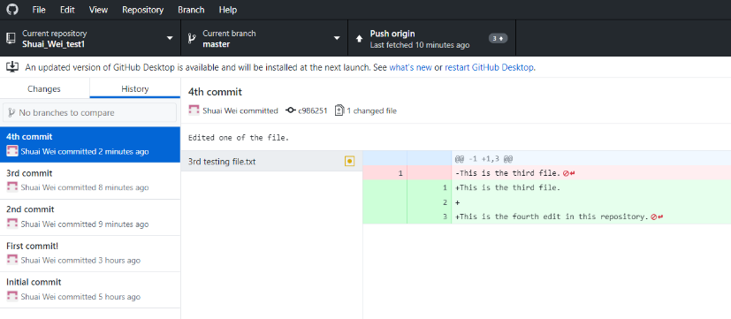
2nd, 3rd, 4th … commits and a push

Slide 20
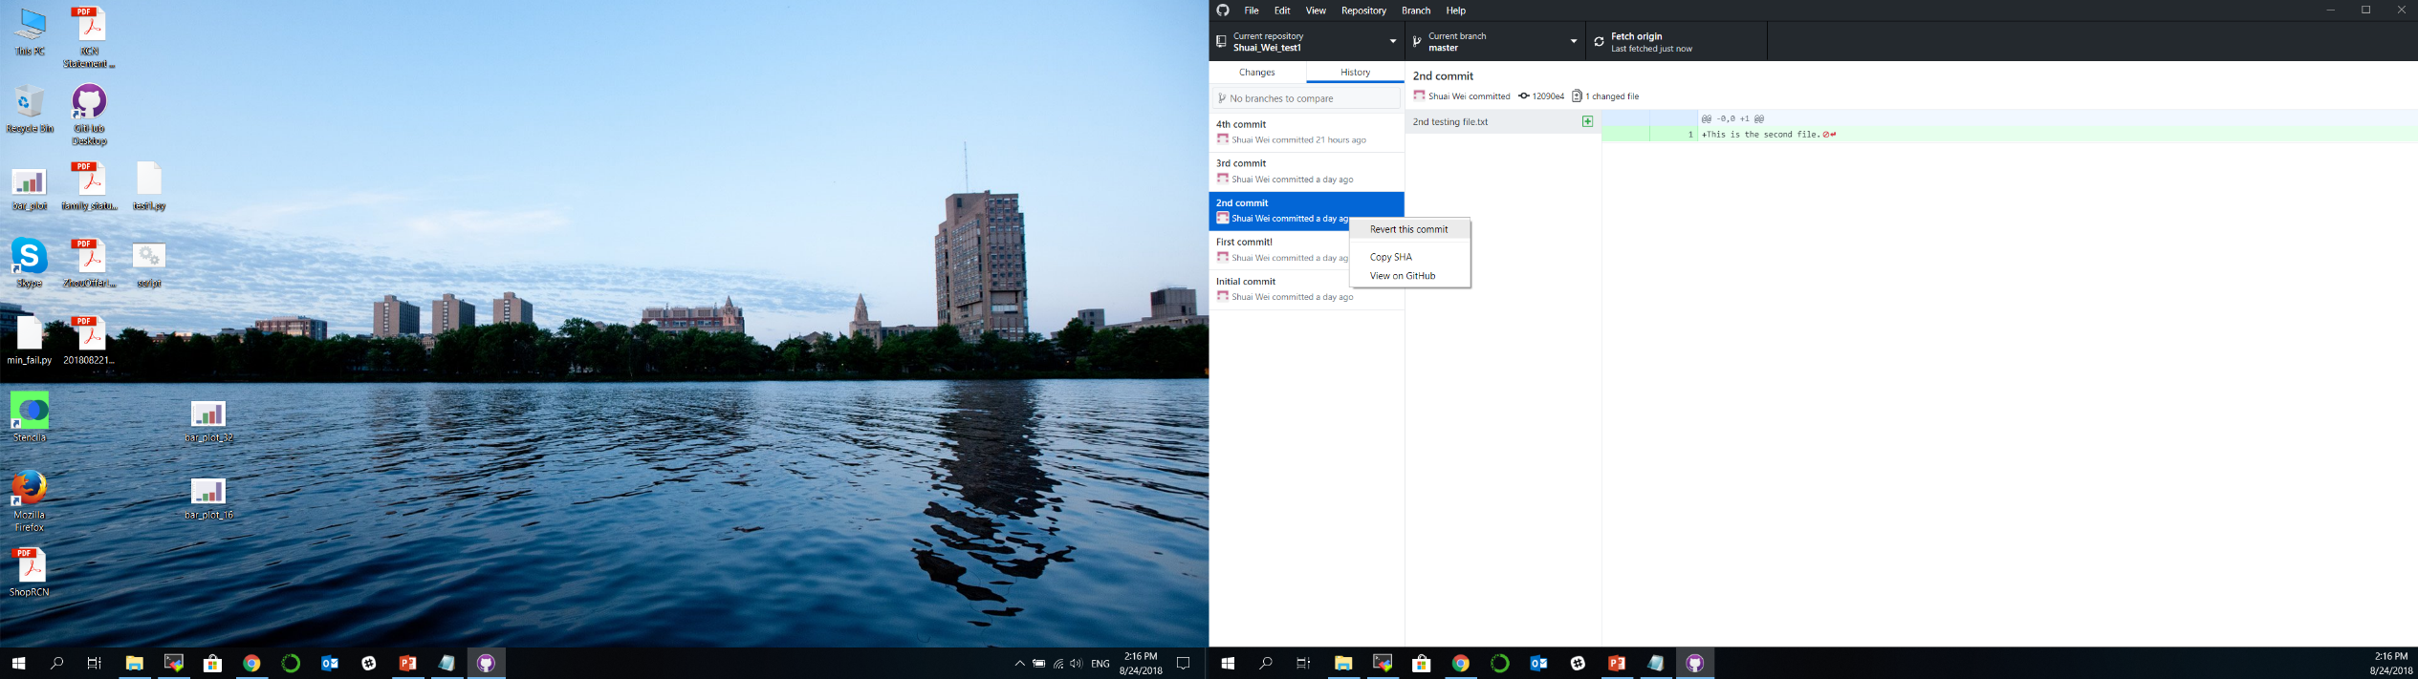
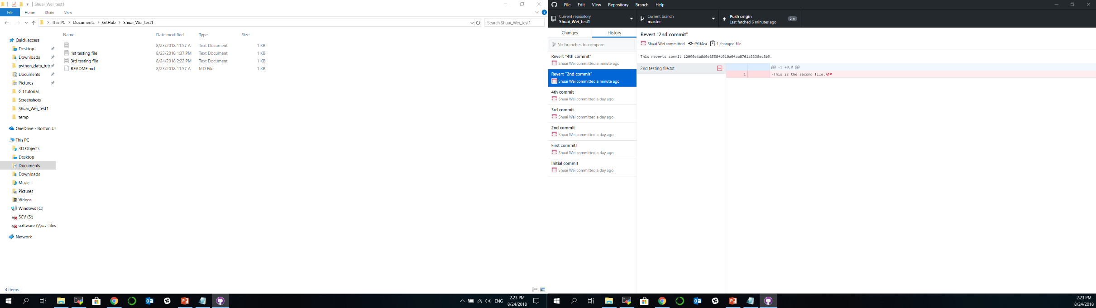
We would like to revert a previous version
Right click on this commit point.

Slide 21
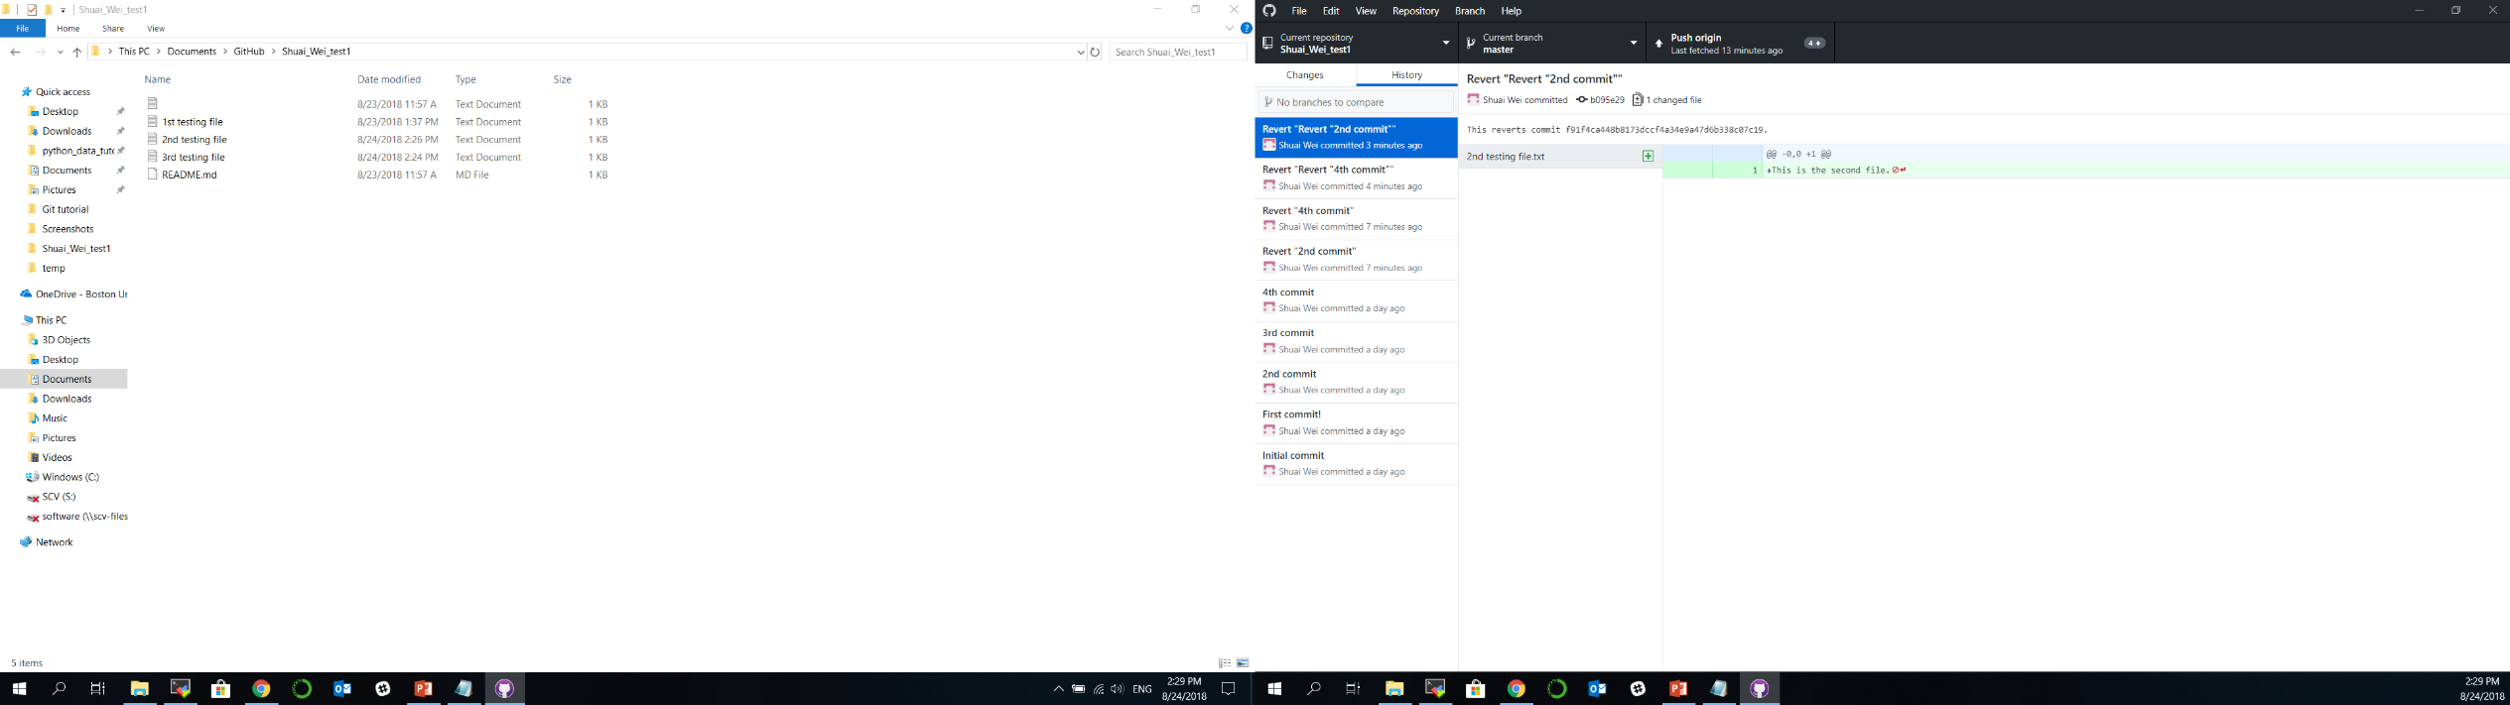
Revert “Revert” commit

Slide 22
Collaborating on a project
Authorize collaborators to a private project.
Each collaborator check out/clone a copy from the github.com repository to their local computer.
Merge back to the origin repository.
Resolve conflict with collaborators.

Slide 23
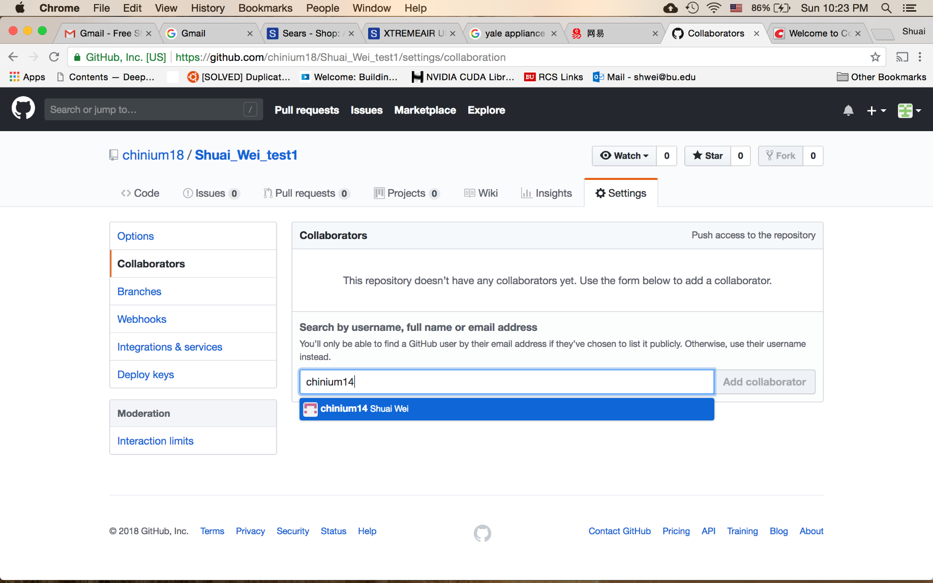
Adding collaborator to your project (repository)
Your collaborator’s github.com username

Slide 24
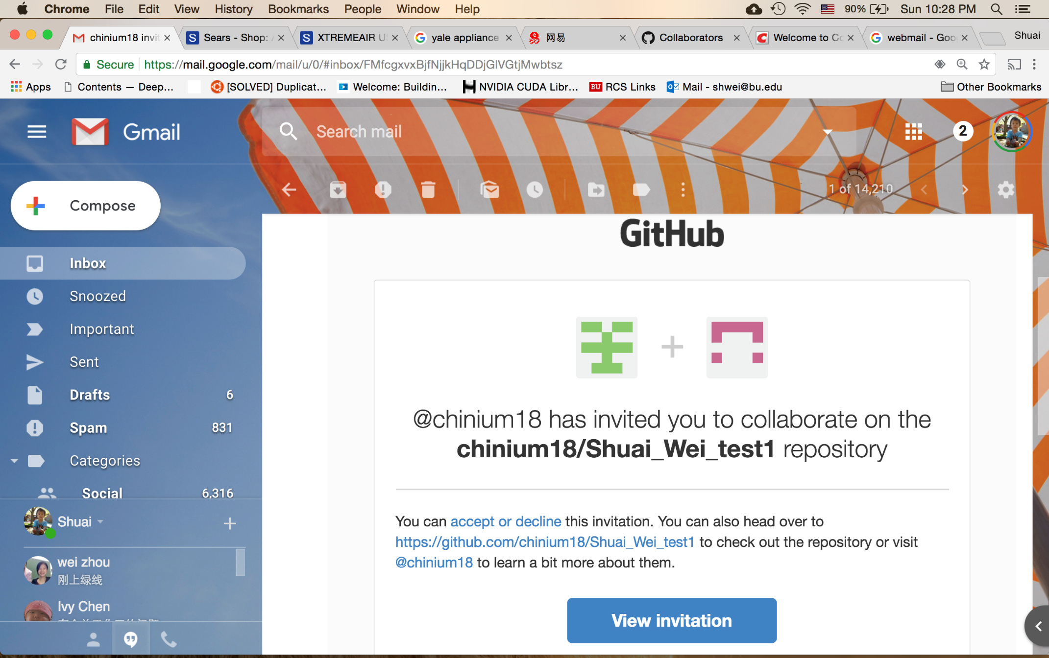
The collaborator will get an email.

Slide 25
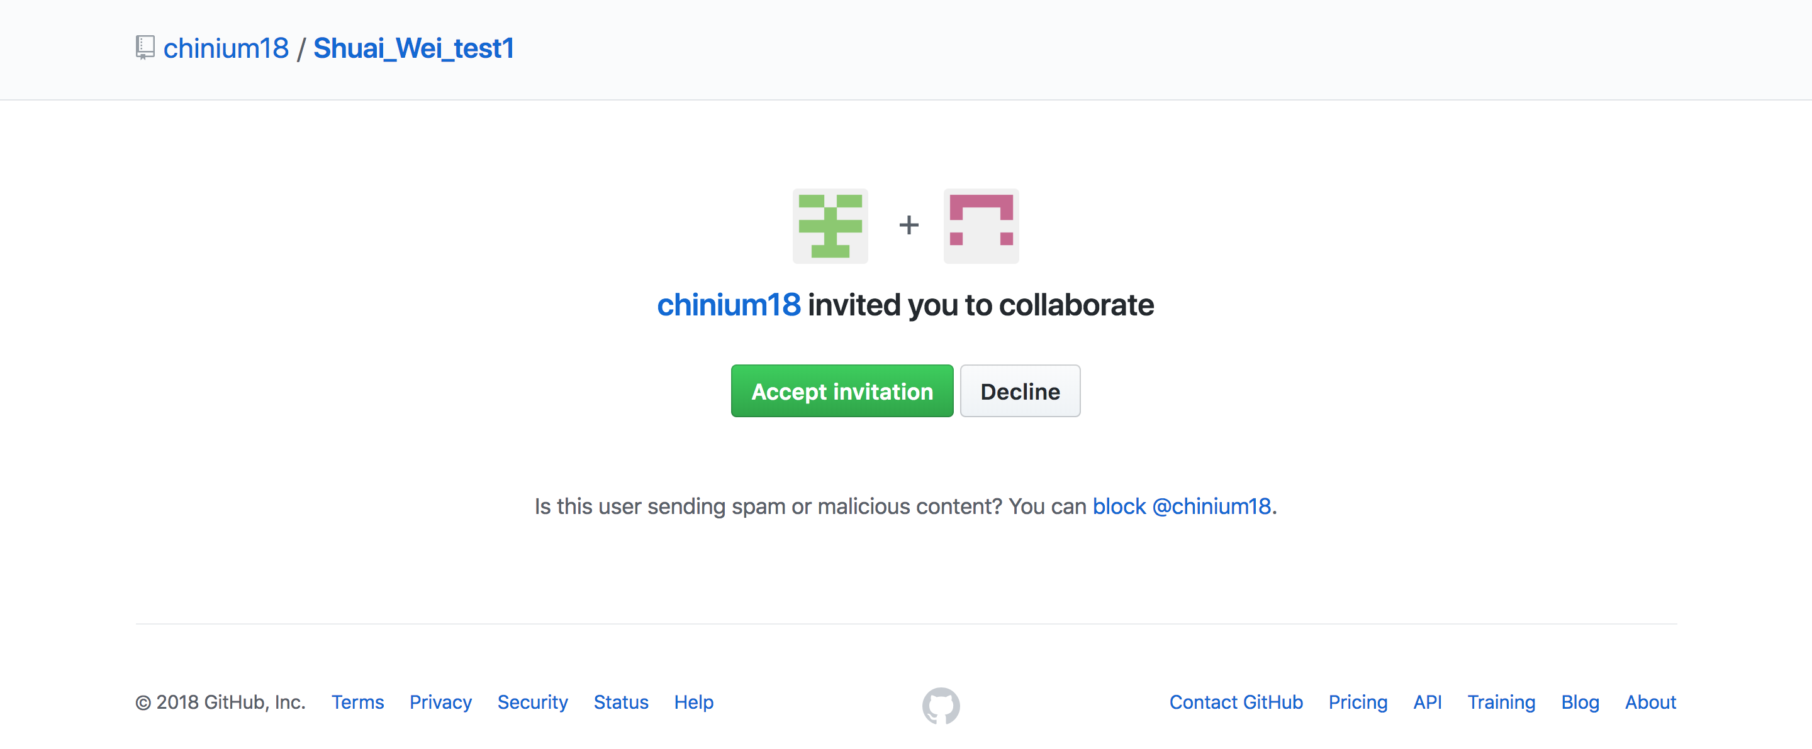
The collaborator: may check your email and find the link to this page.
Click on this button to accept the invitation.

Slide 26
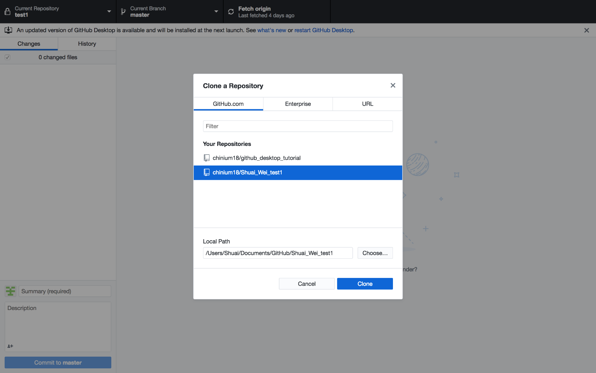
The collaborator: clone a repository from the organizer.

Slide 27
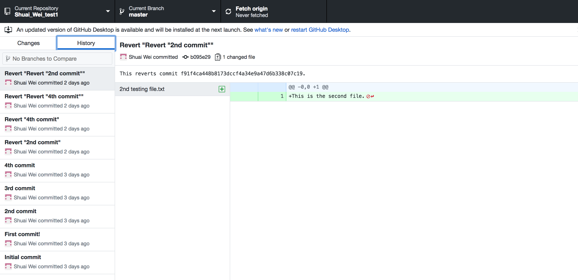
The collaborator can check out the git repository

Slide 28
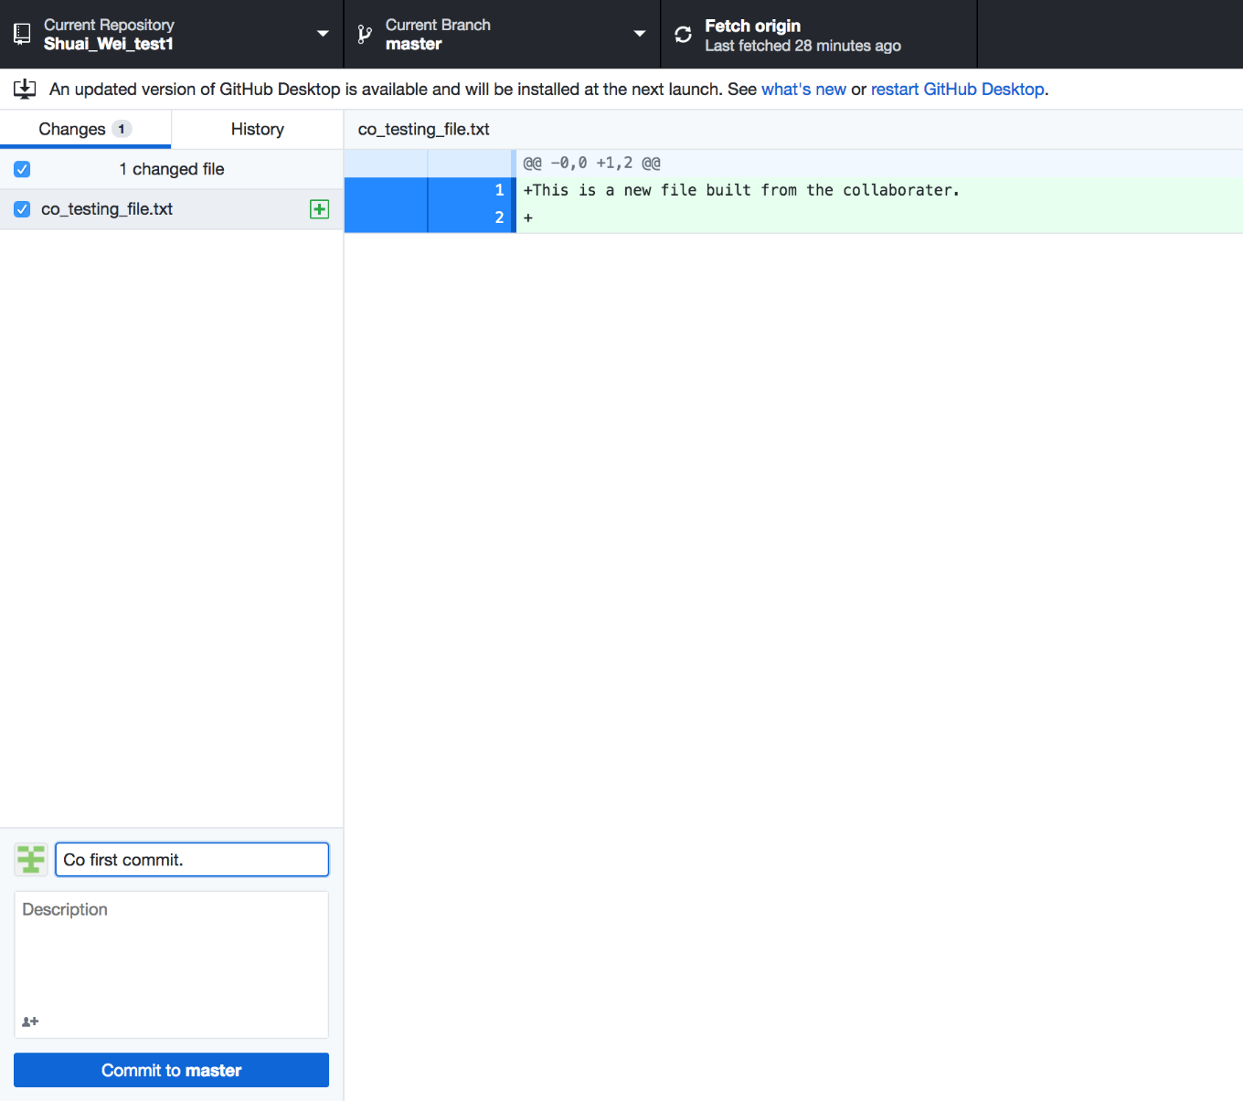
Now the collaborator can make some contribution to the repository: add a file.

Slide 29
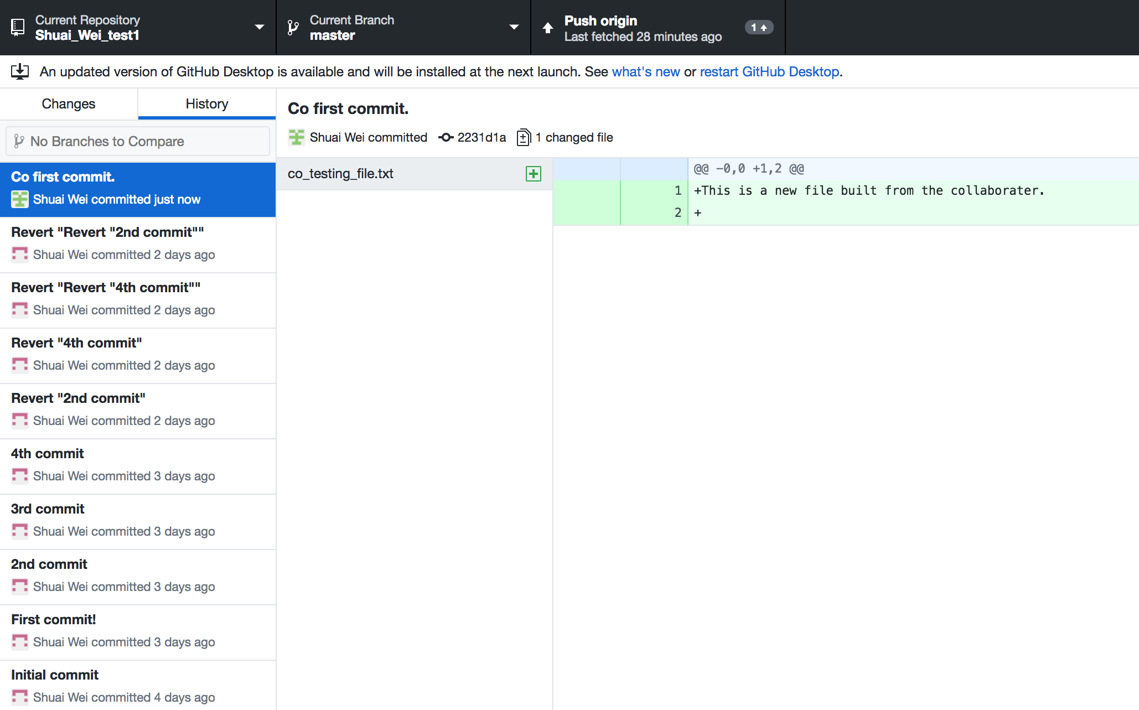
And simply push the commit to the origin repository.

Slide 30
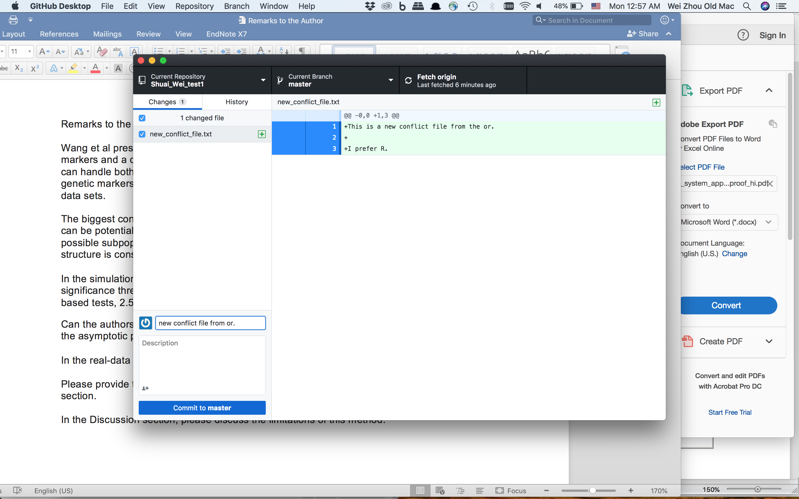
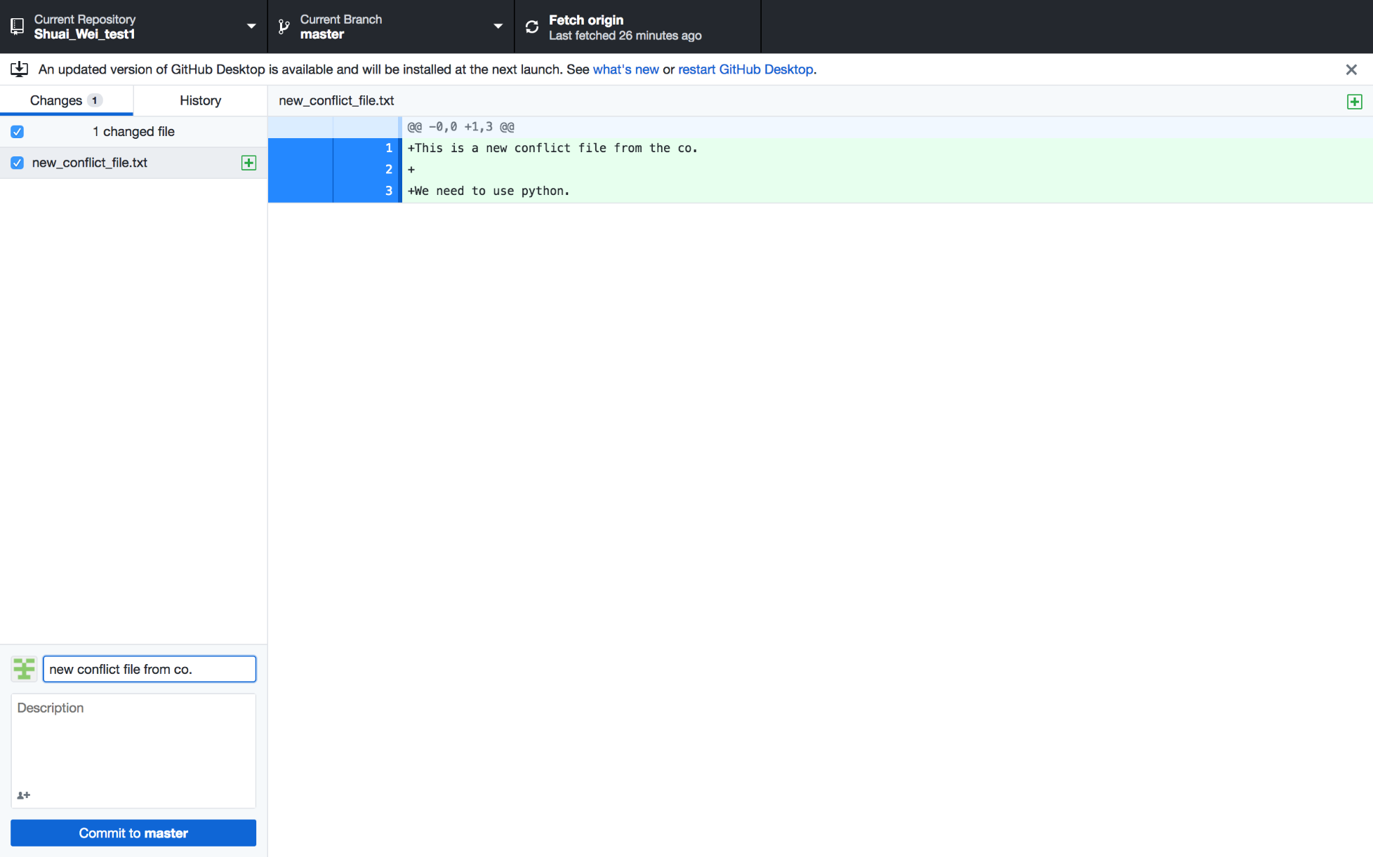
Generate a conflict between collaborators: same file name but different contents.
Conflicts here!

Slide 31
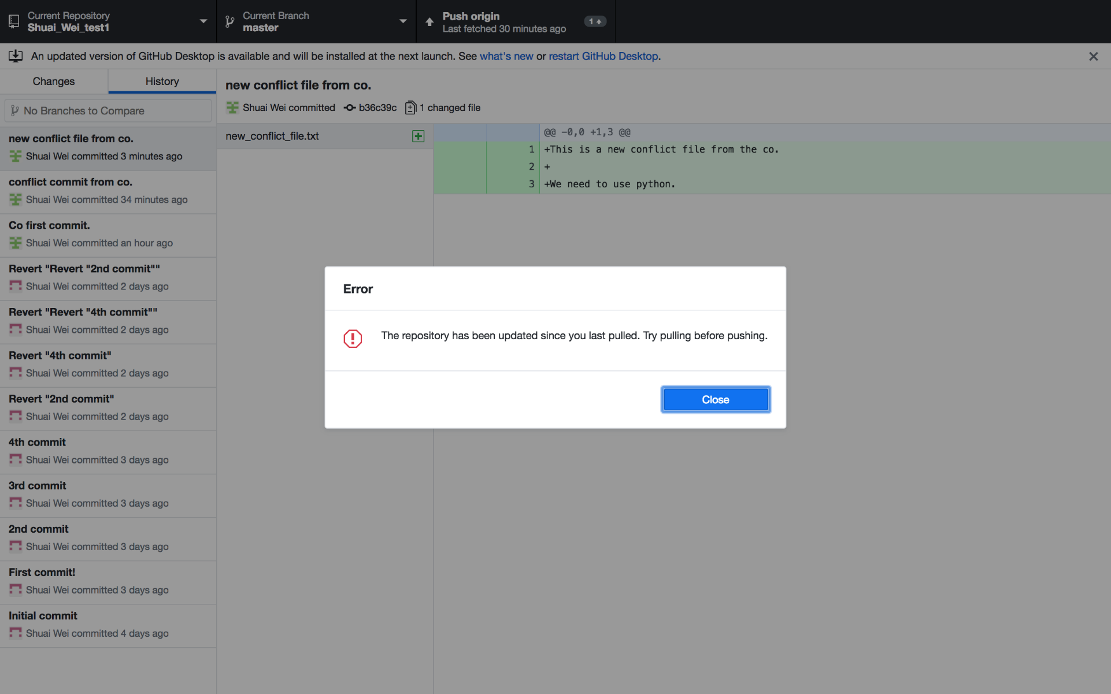
Push to the origin if you are on the latest version.

Slide 32
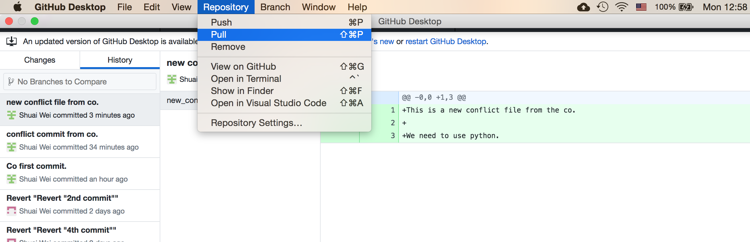
Pull the most updated version from repository

Slide 33
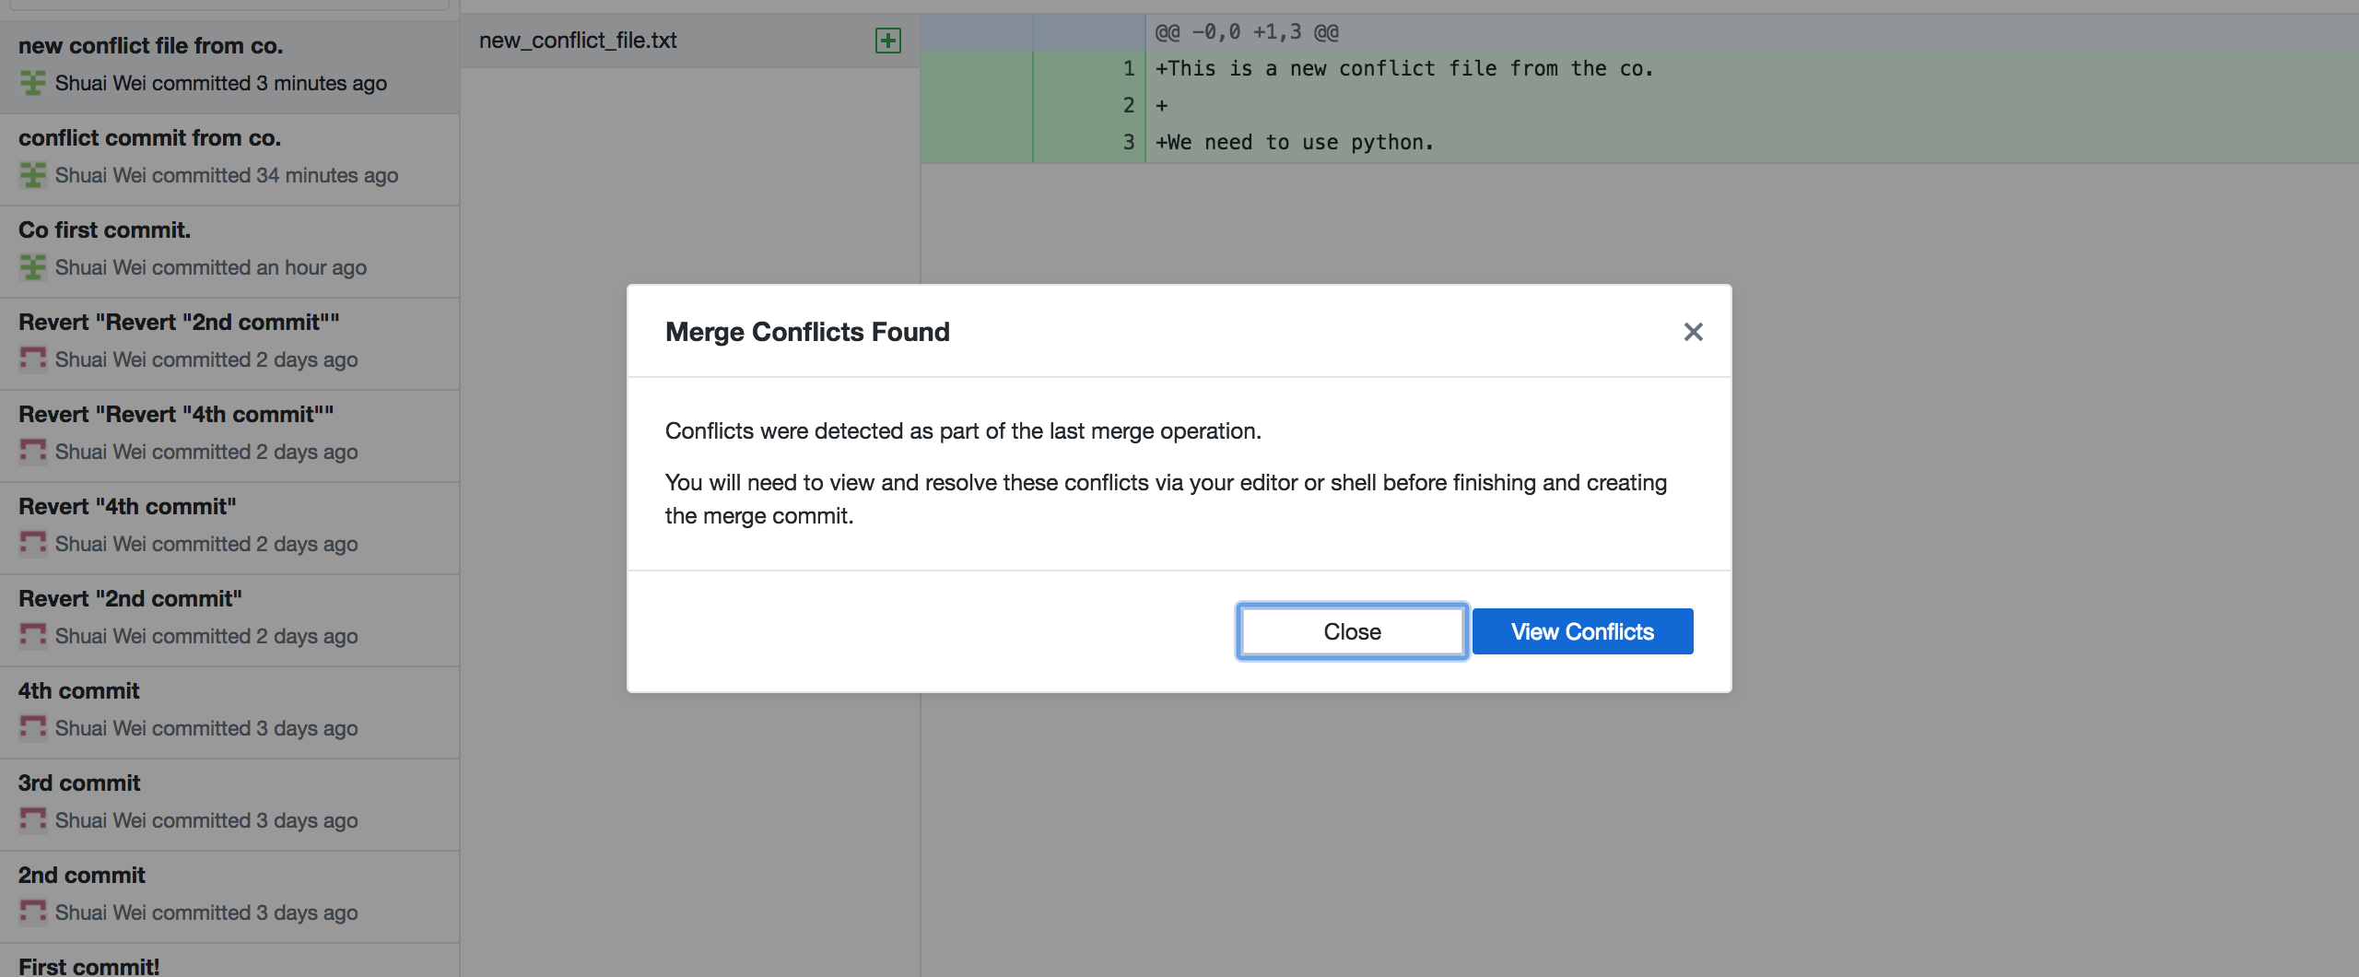
The merge conflicts found!

Slide 34
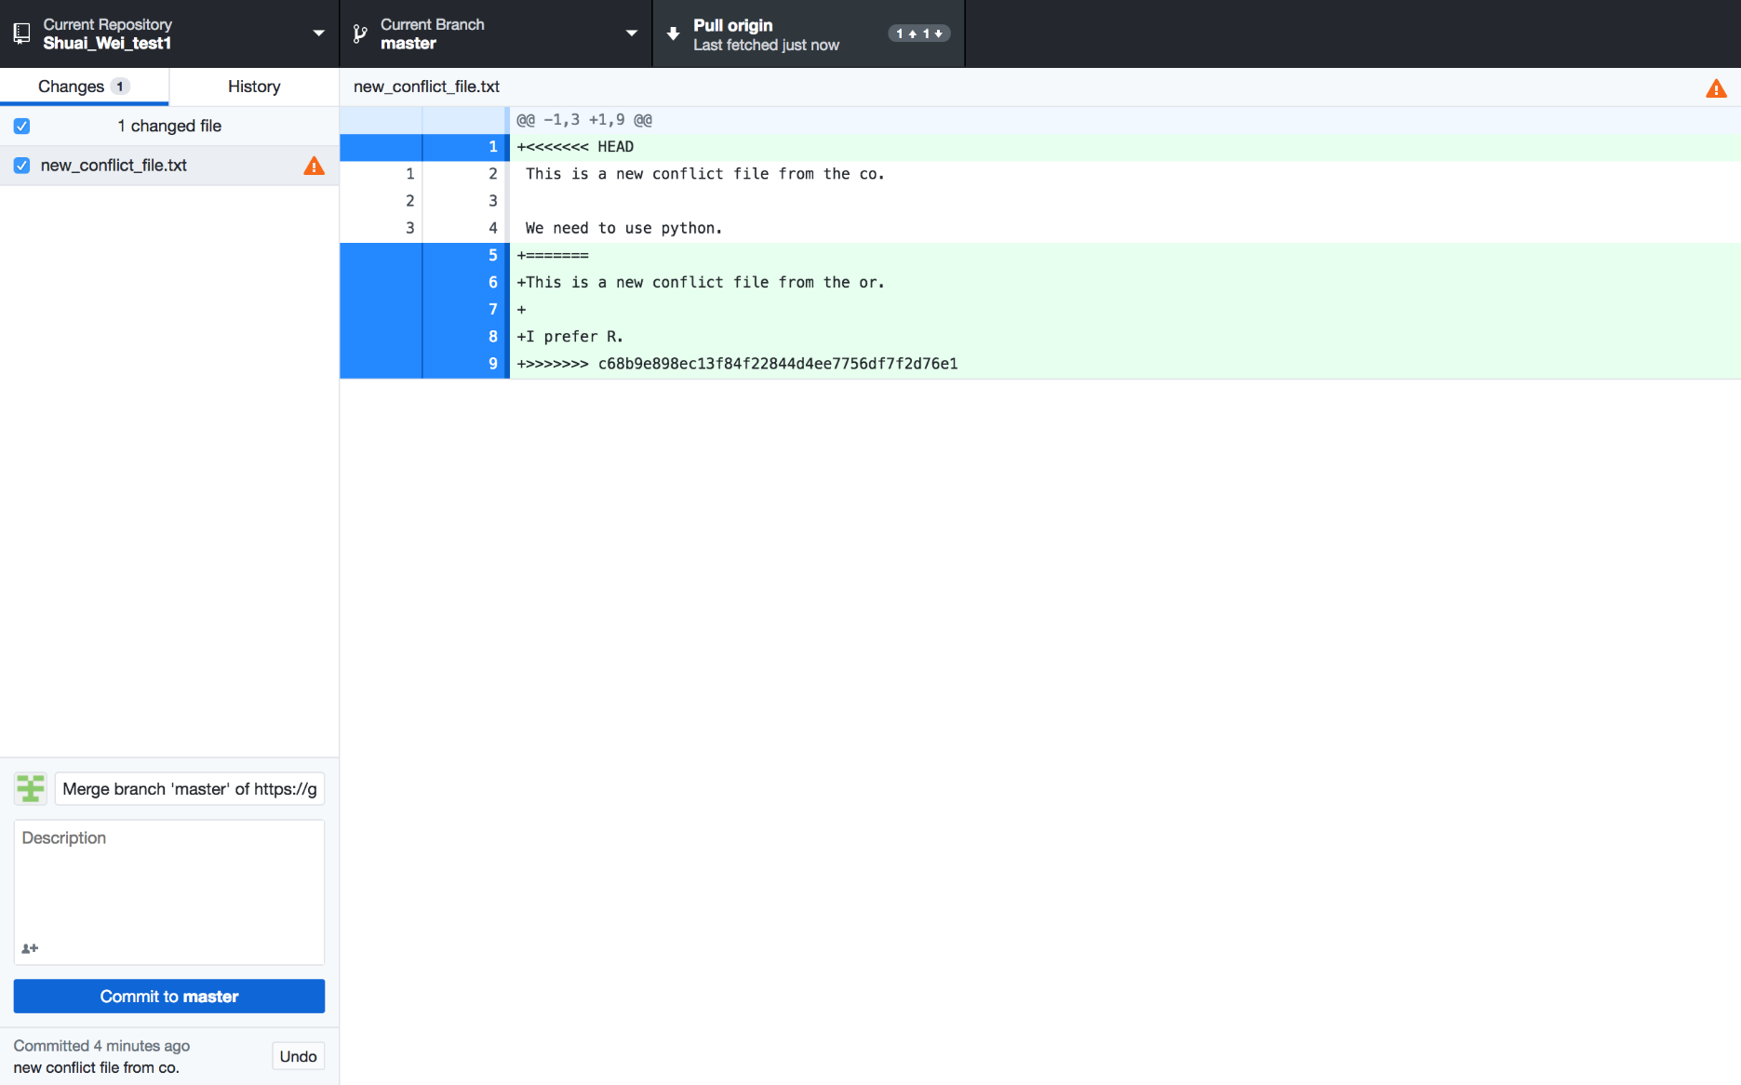
Viewing the conflict: in the file that conflicts.

Slide 35
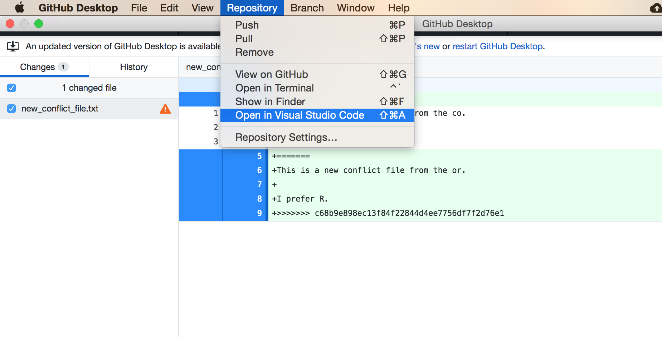
Open this file in VS Code

Slide 36
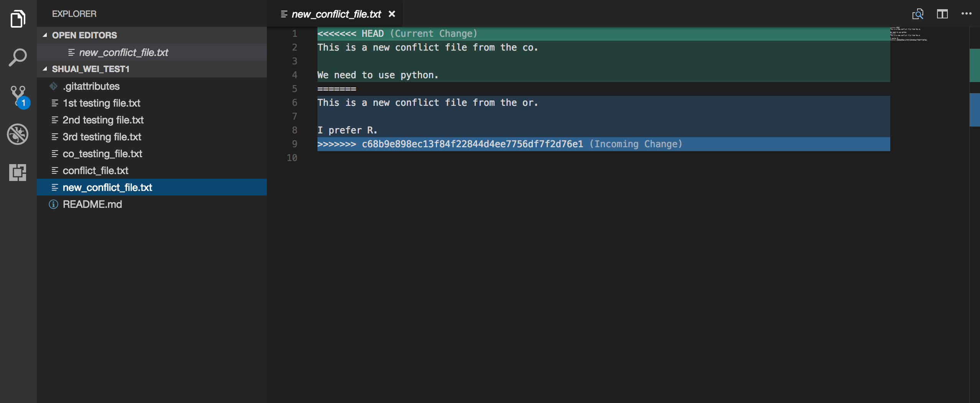
Open the file and edit it together.

Slide 37
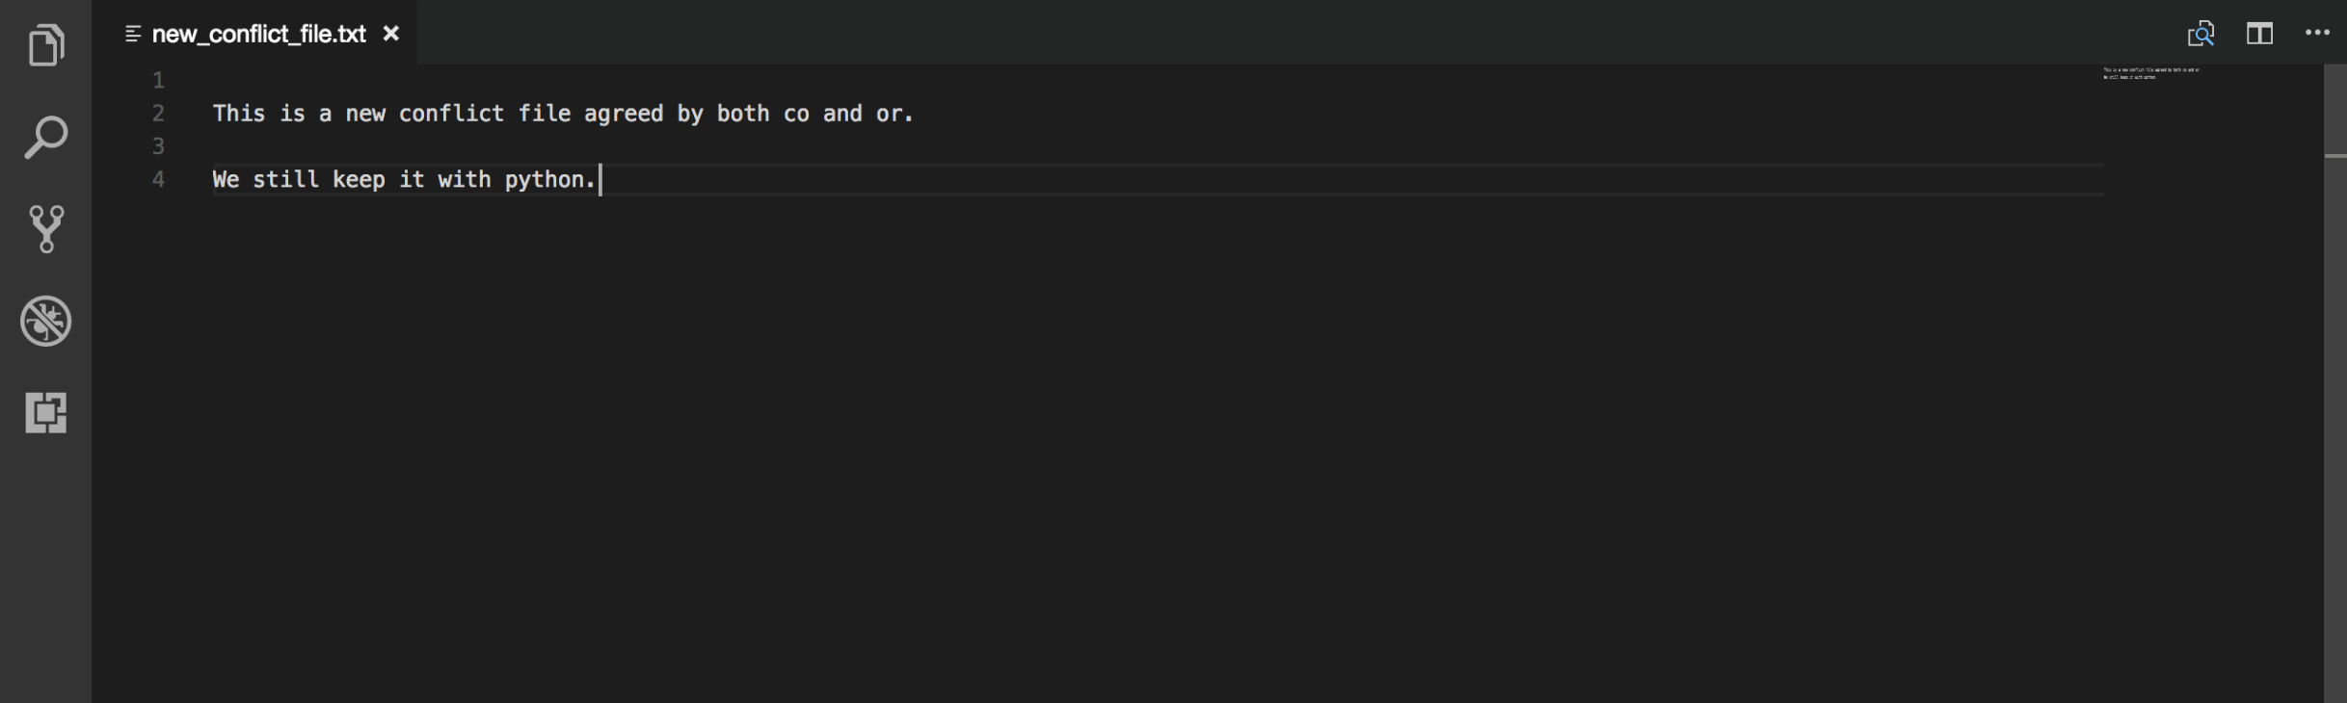
Save the file you edited.

Slide 38
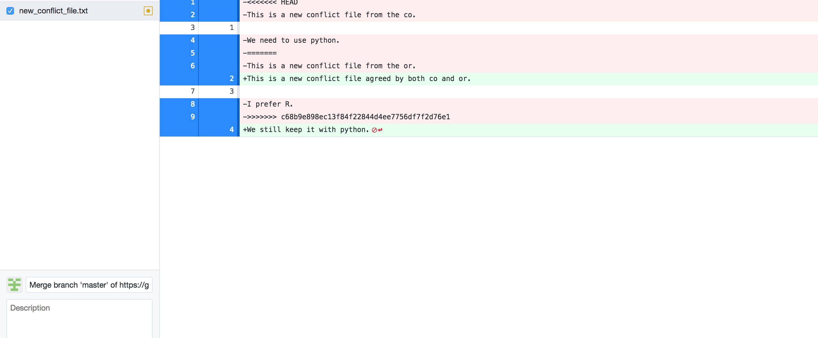
The Github Desktop view

Slide 39
Now you can commit it and push it to the origin.

Slide 40
Extras
For users who are already familiar with command lines.
Other visualization tools such as Gitk.

Slide 41
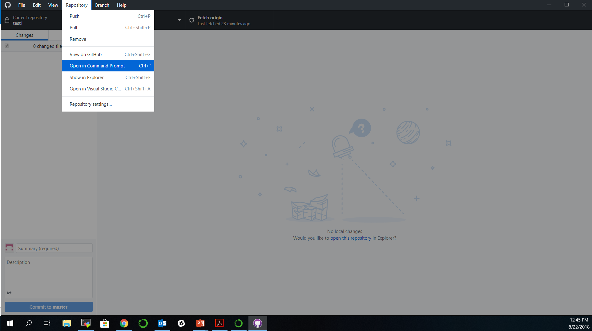
Extras: for command line users

Slide 42
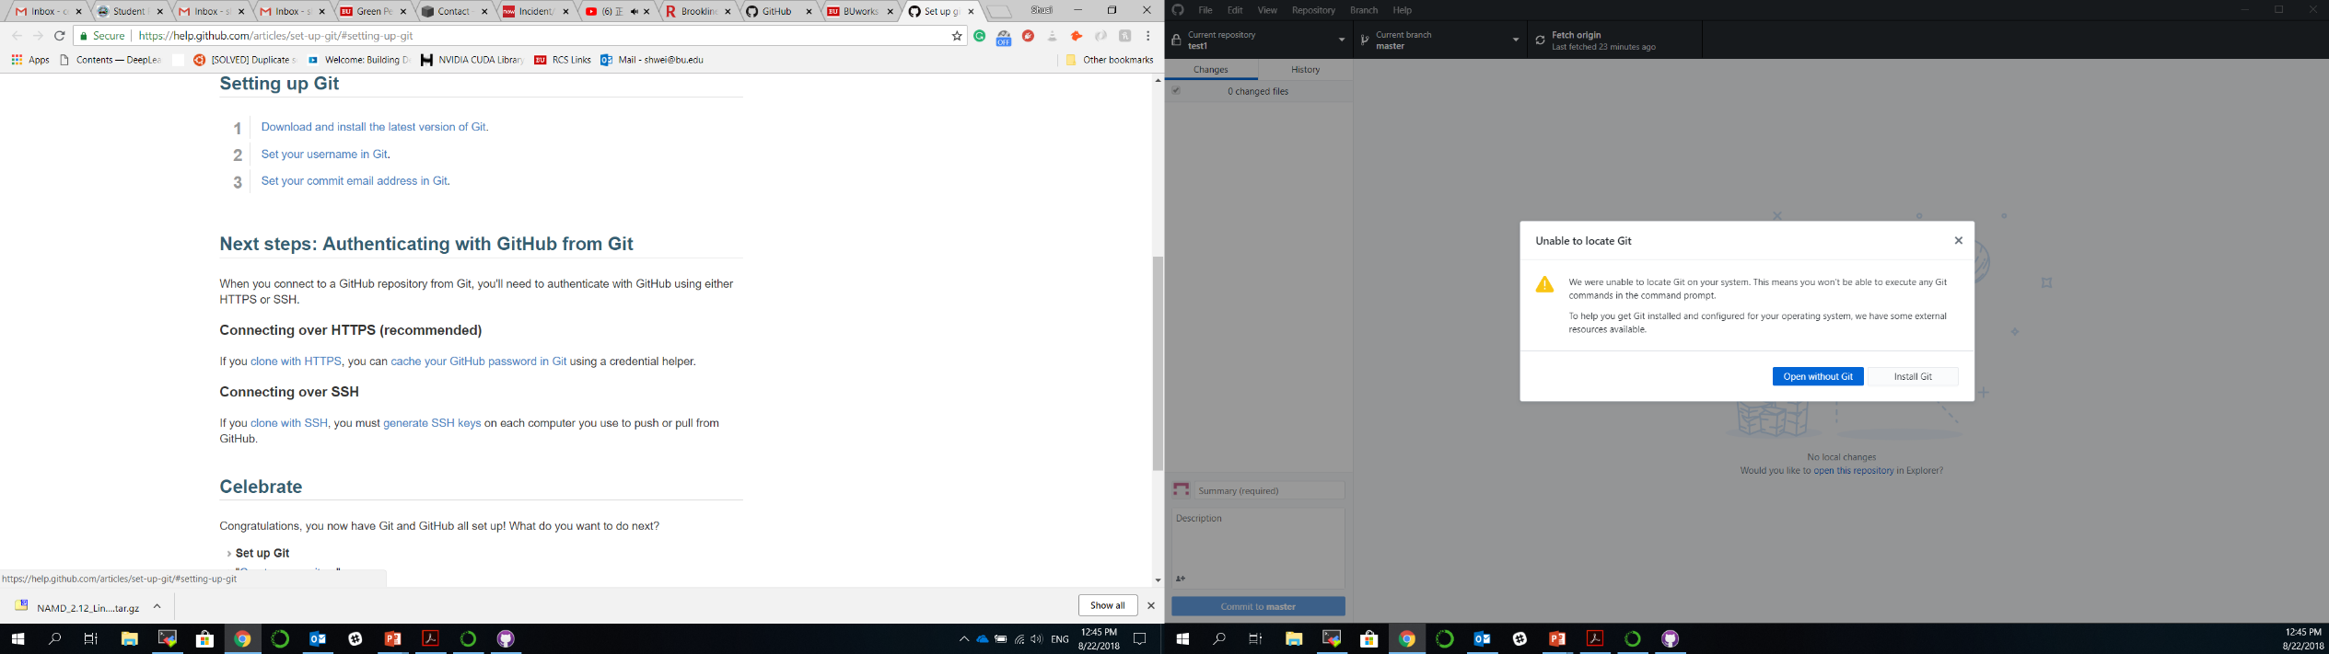
Install Git to use command lines

Slide 43
Instruction for Git setup
https://help.github.com/articles/set-up-git/#setting-up-git

Slide 44
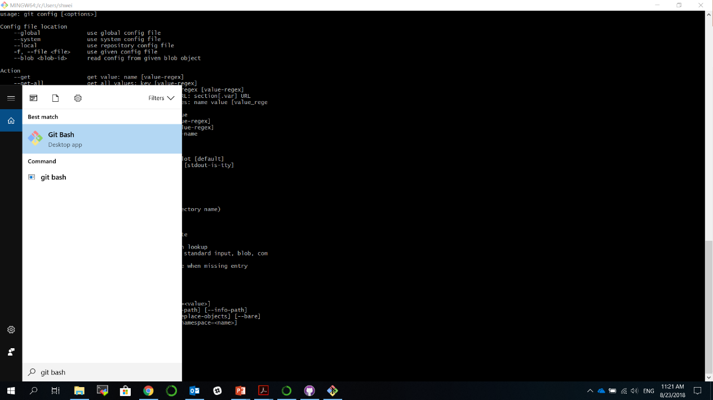
Set up Git

Slide 45
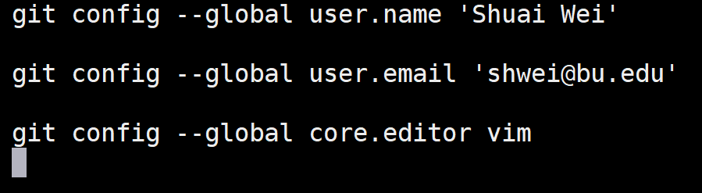
Git basic configuration
Command
Flag
Key
Value
Interpreter
program
Notes:
•Vim is the default editor used by git
•Select gedit if you are not familiar with vim or emacs editors

Slide 46
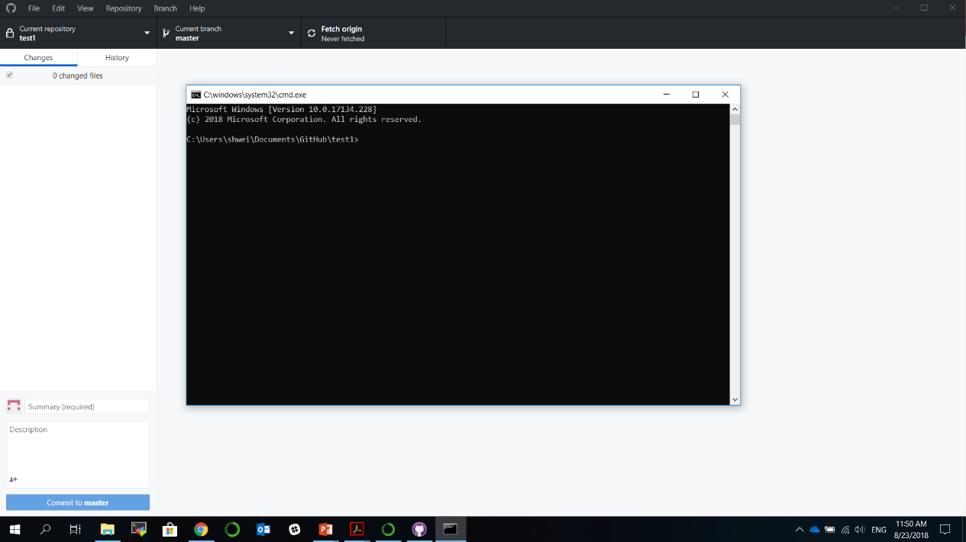
Now the command line will be available.

Slide 47
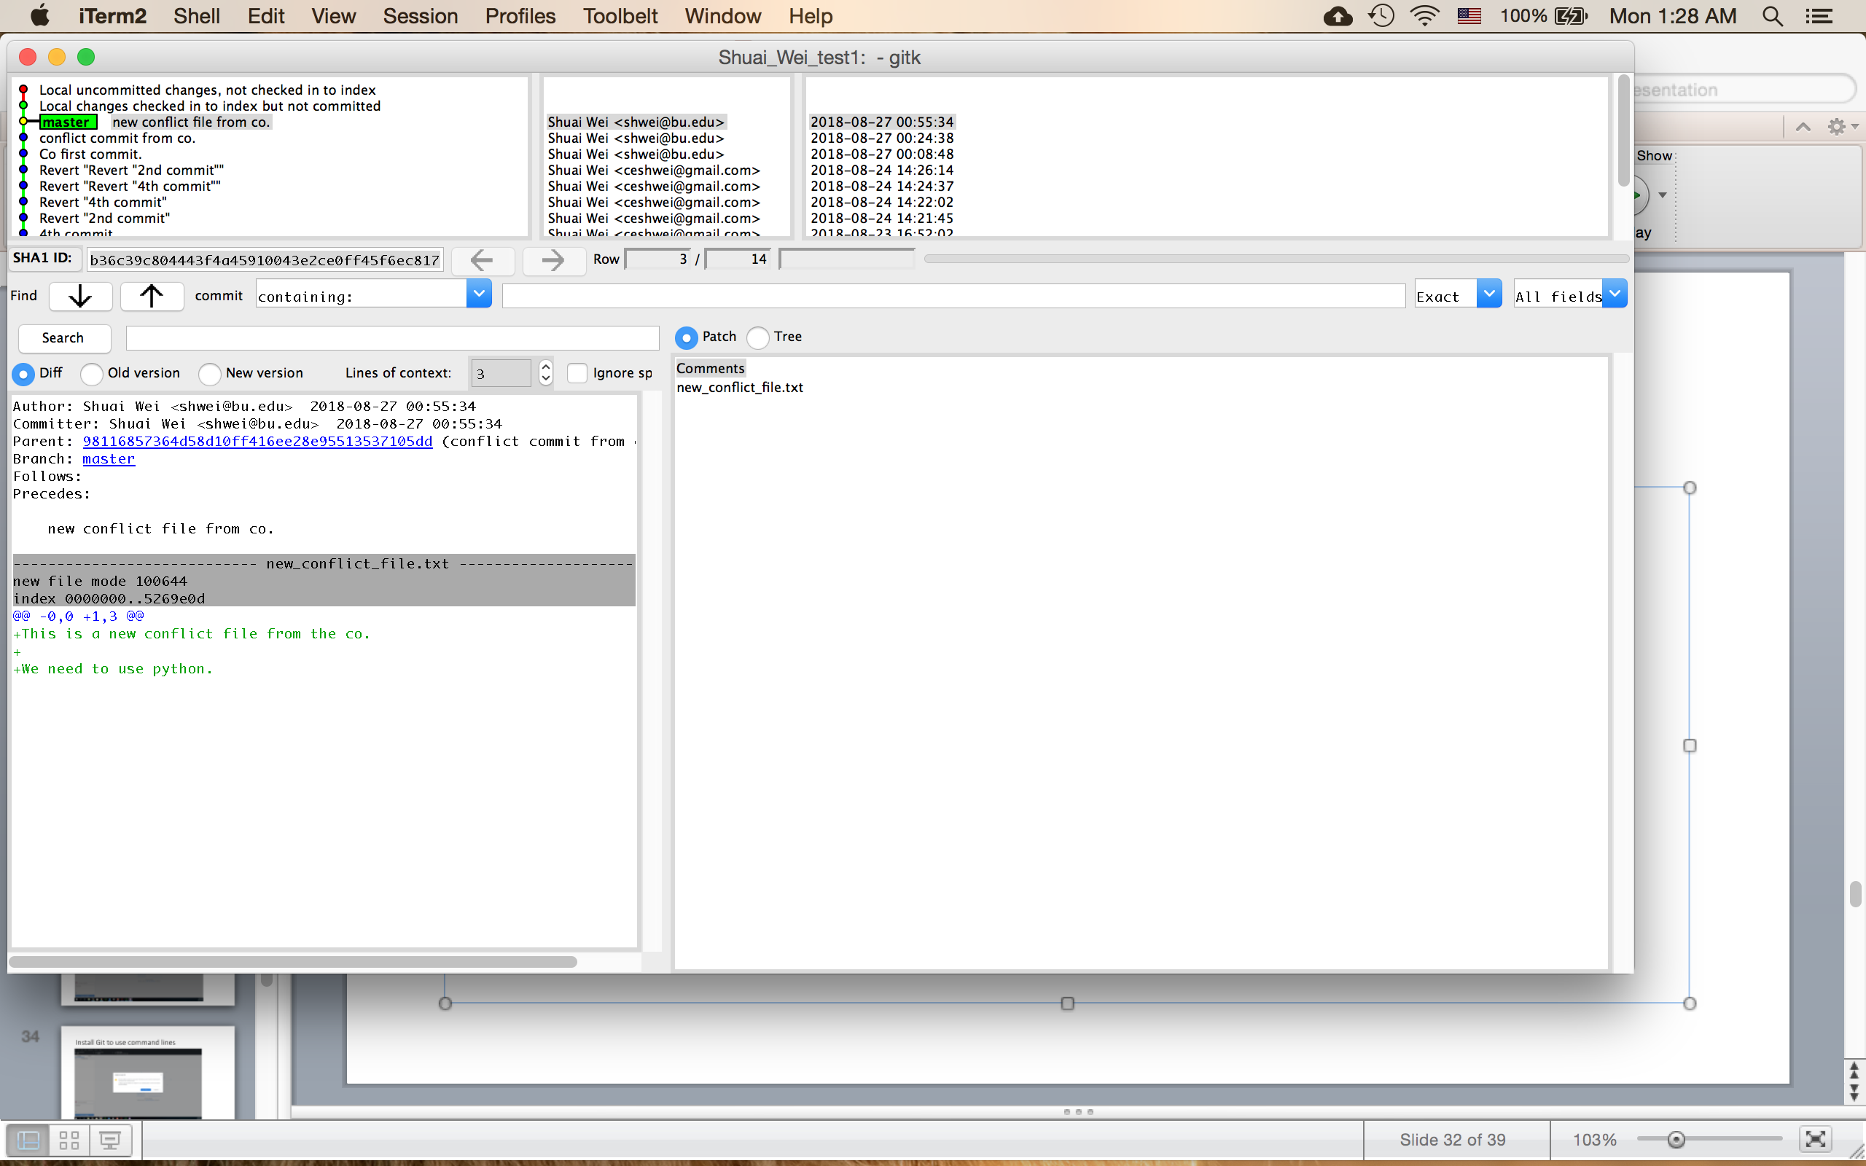
Gitk

Slide 48
Different status of files in a Git repository.

Slide 49



Branch your project

Slide 50



Make changes on the new branch

